Slide 1

GVC Data Workshop
October 31, 2019
Erika Bethmann, Lin Jones, Mihir Torsekar, and Ricky Ubee

Slide 2
Housekeeping items
GVC working group (est. 2017) aims to generate Commission-related GVC research from ID and EC.
What’s been done so far?
  Online GVC Library: https://usitc.libguides.com/gvcs
  JICE GVC Special Topic Edition: https://www.usitc.gov/journals/2019_global_value_chains.htm
  15 GVC seminars and brownbag discussions
Upcoming events: April 28th, GVC Roundtable

Slide 3
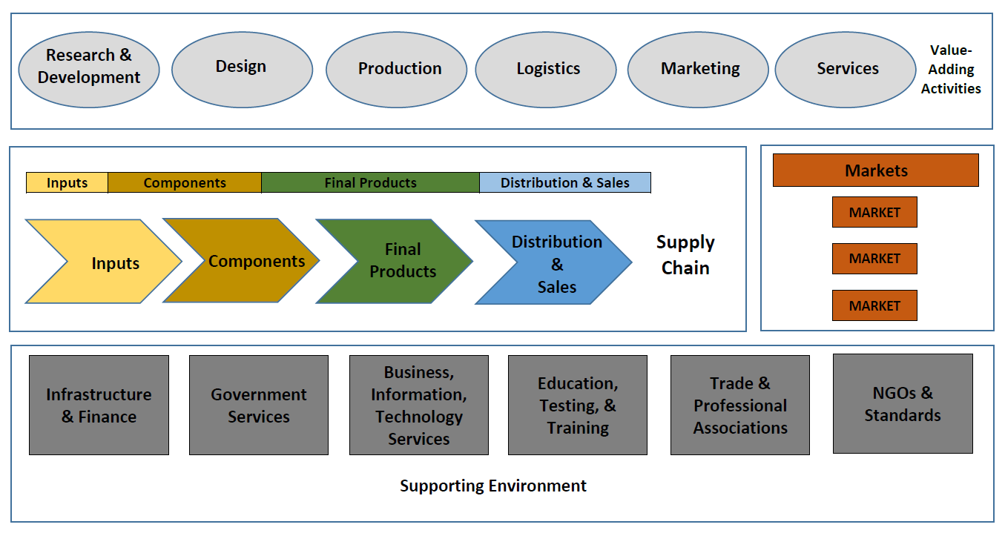
GVC Ecosystem and Analytical Tools
Global value chain
Include tangible and intangible inputs
Trade in value added approach
Global supply chain
Covers the international production process as well as cross-border movement of tangible goods
Merchandise trade statistics by end use
Source: Fredrick (2010 and 2014)

Slide 4
Agenda
Global supply chain analysis: merchandise trade statistics by end use approach
  Overview of the Measuring-Competitiveness in GVCs Database (Mihir)
  APEC-USITC End-use Concordance Data (Erika & Lin)
Global value chain analysis: Trade in value added approach
  Trade in Value Added (TiVA) for GVC Analysis (Lin)
  Calculating Value Added Estimates with STATA (Ricky)

Slide 5

OVERVIEW OF THE MEASURING COMPETITIVENESS IN GVCs (MC-GVC) DATABASE
Mihir Torsekar
Office of Industries

Slide 6
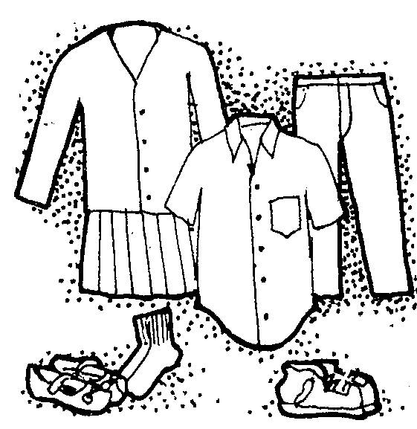


Introduction
MC-GVC database tracks intermediate and final goods trade for five industries:
  Apparel/footwear (can be split)
  Autos (can be split into passenger vehicles and commercial vehicles)
  Electronic products
  Textiles
Why these sectors?
  All are characterized by a lead-firm network structure
  GVC-intensive (i.e. heavy trade in intermediates)

Slide 7
What are the advantages?
Accessible: Uses traditional merchandise trade data (more mathematically accessible).
Compliments other value-added databases:
  TiVA (OECD)
  EORA (UNCTAD)
  Asian Input-Output tables (IDE-JETRO)

Slide 8
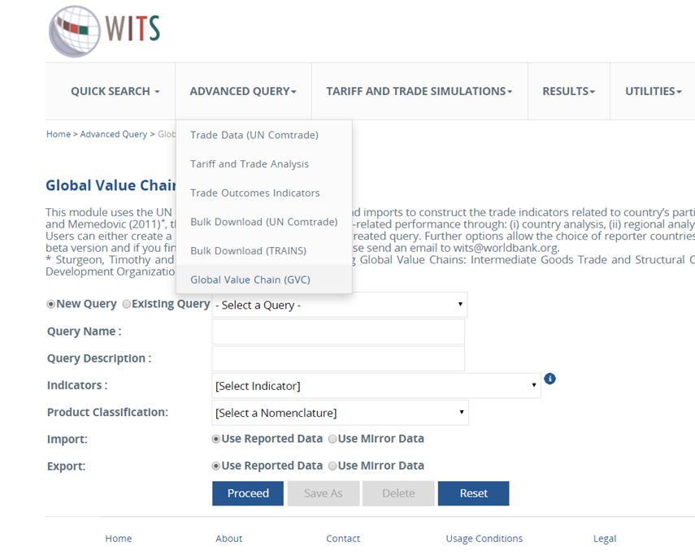
How to access it?
Register for an account on http://www.wits.worldbank.org
Once validated, go to the Global Value Chain (GVC) link on the “advanced query tab.”
Indicators are: analysis by country, region, inter-region, product of interest
Product classification just means years to select. (1988 onward).

Slide 9
Possible research questions?
What are the trade flows of intermediate goods vs. final goods?
What are the most GVC-intensive regions for each of the available sectors?
What are some notable trends in GVC-participation?
Research that has used this database:
“Using Gross Trade Data to Map Archetypal GVCs,” World Bank, 2018.
“South Asia’s Turn,” World Bank, 2017.
“East Asia-Pacific’s Participation in the GVC for Electronic Products,” JICE, 2018

Slide 10
How has East Asia-Pacific’s (EAP) participation in the GVC for electronic products evolved over the past 20 years?
  Thing to look for: intermediate goods trade in the region; trade in intermediate goods is a good proxy for GVC participation.
  Finding: imports of intermediate electronics to Malaysia, Singapore, Thailand, and Vietnam are shifting from China. But China still claimed 55 percent of the share.
  Thing to look for: regional trading patterns for electronic product GVCs.
  Finding: Intra-EAP GVC trade has grown by 21 percentage points (1996-2016).

Slide 11
How has East Asia-Pacific’s (EAP) participation in the GVC for electronic products evolved over the past 20 years?
  Thing to look for: Country-specific analysis for China?
  Finding: China remains the driver of GVC trade in electronic products, but there has been a divergence towards exports of final goods over the past 20 years.

Slide 12
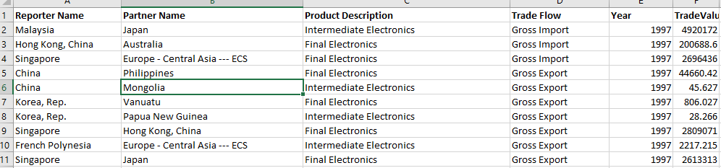
What do the queries look like?
Data is pivot-table ready

Slide 13
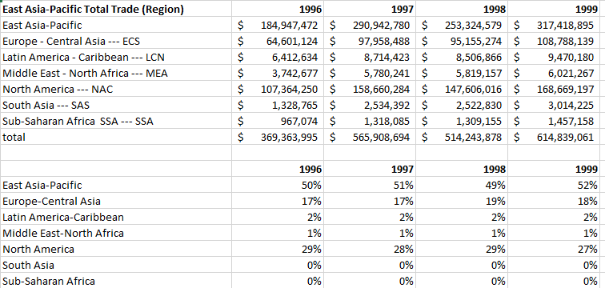
What do the queries look like?
From which I tallied summary statistics

Slide 14
Wrap-up
The MC-GVC database is accessible and relatively easy to use.
It affords analysis of the five most GVC-intensive industries.
It allows for multiple dimensions of analysis, including country, regional, and product-specific analysis

Slide 15
APEC-USITC End-use Concordance data
Erika Bethmann and Lin Jones
GVC Data Workshop
October 31, 2019

Slide 16
Outline
What is end-use?
Why is end-use important?
Data structure and sources
Concordance Demo
Application for GVC Analysis
Future work

Slide 17



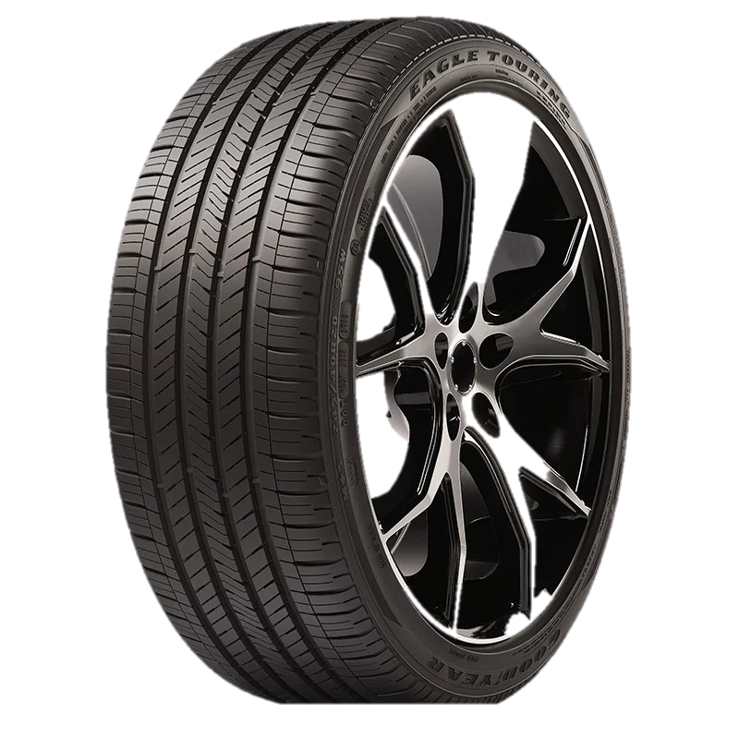
What is end-usE?
End-use : how a product is used by an industry or the domestic market (source: UNSD BEC Classification)
    Final consumption (CONS)
    Intermediate consumption (INT)
    Gross fixed capital formation (CAP)
    Dual use (DUAL-USE)

Slide 18
Why is End-Use Important?
EBOT: “China’s Move up the Value Chain through More Complex Intermediate Exports”
Source: UN Comtrade
Notes:
Consumer, intermediate, and capital goods have different trade patterns and different supply and demand factors
End-use classification helps better understand a country’s specialization and competitive advantage in global production
Product-level end-use allows for in-depth examination and mapping of an industry’s production process and sourcing patterns over time.
Signals areas where key actors and/or policies may be driving specialization in a particular segment of a GVC.
Produces micro-level understanding of sector supply chains (apparel and textiles, electronics, autos, etc.)

Slide 19
Data Structure
Product classification:
  4 and 6-digit Harmonized System (HS)
  U.N. Central Product Classification (CPC)1.0
Industry classification:
  International Standard Industrial Classification (ISIC) 3.0
  ISIC 4.0
  GTAP 56 sectors
End-use classification
  Consumer goods (CONS)
  Intermediate goods (INT)
  Capital goods (CAP)
  Dual-use goods (DUAL-USE)

Slide 20
Data Source
UNSD Broad Economic Categories (BEC) classification
End-use classification from World Input-Output Database (WIOD) project
End-use concordance from OECD TiVA database
OECD HS-ISIC v3. and HS-ISIC v4. concordance
USITC estimates on certain dual-use products
The differences between these sources have been reconciled

Slide 21
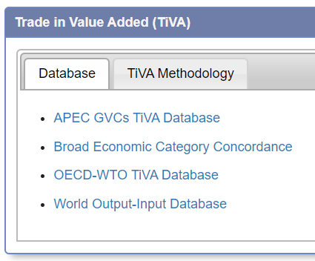
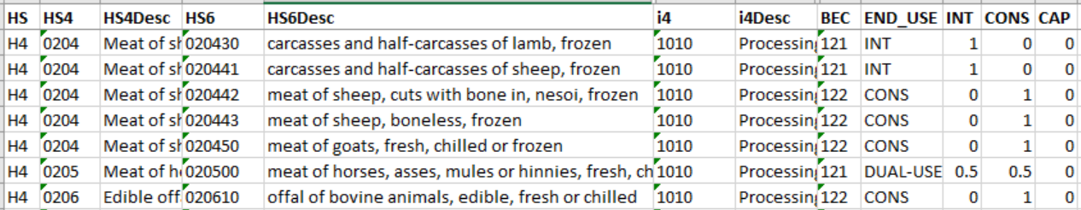
APEC-USITC END-USE Concordance DEMO
Available via Intranet GVC library: https://usitc.libguides.com/gvcs
  Scroll down to Database section and select Broad Economic Category Concordance
Notes:
Shout-out upcoming China manufacturing EBOT
Product-level end-use allows for in-depth examination and mapping of an industry’s production process and sourcing patterns over time.
Signals areas where key actors and/or policies may be driving specialization in a particular segment of a GVC.
Produces micro-level understanding of sector supply chains (apparel and textiles, electronics, autos, etc.)

Slide 22
Application for GVC Analysis
Make merchandise statistics more relevant to GVC analysis
Provide more timely GVC analysis with detailed product and industry information
Help improve the compilation of TiVA database
Add additional dimensions to other modeling tools (Gravity, GTAP, PE models etc.)
Better estimate of policy implications
Notes:
Shout-out upcoming China manufacturing EBOT
Product-level end-use allows for in-depth examination and mapping of an industry’s production process and sourcing patterns over time.
Signals areas where key actors and/or policies may be driving specialization in a particular segment of a GVC.
Produces micro-level understanding of sector supply chains (apparel and textiles, electronics, autos, etc.)

Slide 23
Future Work
Collaboration with GTAP working group
  Adding new GTAP sectors
  Adding GTAP sector splits
Collaboration with Industry Analysts
  Lesley Ahmed and Sarah Scott are testing out how much time it will take to review the products in their portfolio
  More accurate allocation for dual-use products
  Misclassifications

Slide 24
Questions?

Slide 25

Trade in Value Added (TiVA) for GVC Analysis
by
Lin Jones
USITC GVC Research Program: GVC Data Workshop
October 31, 2019

Slide 26

Outline
What is Trade in Value Added (TiVA)?
Major TiVA databases
TiVA data
  Inter-country input-output table
  Basic TiVA measures
TiVA Application for GVC analysis
Pros and cons of TiVA

Slide 27

What is Trade in Value Added (TiVA)?
It is a different statistical approach to measure trade and global value chains (GVCs).
TiVA allows to untangle value embedded in final consumption to the originating countries and industries.
TiVA is compiled from national account data (e.g. input-output and supply-use tables), as well as trade statistics.
TiVA databases usually contain Inter-country input-output tables (ICIOTs) and/or TiVA measures.

Slide 28

Major TiVA Databases
World Input-Output Database (WIOD)
  2013 release: 40 countries & Rest of World (RoW), 35 sectors, 1995-2011
  2016 release: 43 countries, 56 sectors, 2000-2014
OECD-WTO TiVA Database
  2016 release: 63 economies & RoW, 34 industries, 1995-2011
  2018 release: 64 economies, 36 sectors, 2005-2015 (some 2016)
UNCTAD Eora GVC Database
  2018 release: 189 countries &RoW, 25 sectors, 1990-2018
Other IO databases: IDE-JETRO AIIOTs, EUROSTAT FIGARO, ADB MRIO, EXIOBASE, GTAP, APEC TiVA, NA TiVA

Slide 29
TiVA Data: Inter-Country Input-Output Table
 |  |  | Output |  |  |  |  |  |  |  | Total Output
 |  |  | Intermediate Use |  |  |  | Final Use
 |  |  | Econ 1 | Econ 2 | Econ 3 | RoW | Econ 1 | Econ 2 | Econ 3 | RoW
 |  |  | 1……n | 1……n | 1……n | 1……n | 1…e | 1…e | 1…e | 1…e
Input | Econ 1 | 1 . . . n | ID¹_{i,j} | IM^{1,2}_{i,j} | IM^{1,3}_{i,j} | IM^{1,row}_{i,j} | FD¹_{i} | FM^{1,2}_{i} | FM^{1,3}_{i} | FM^{1,row}_{i} | O¹_{i}
 | Econ 2 | 1 . . . n | IM^{2,1}_{i,j} | ID²_{i,j} | IM^{2,3} _{i,j} | IM^{2,row}_{i,j} | FM^{2,1,c}_{i} | FD²_{i} | FM^{2,3}_{i} | FM^{2,row}_{i} | O²_{i0-}
 | Econ 3 | 1 . . . n | IM^{3,1}_{i,j} | IM^{3,2}_{i,j} | ID³_{i,j} | IM^{3,row}_{i,j} | FM^{3,1}_{i} | FM^{3,2}_{i} | FD³_{i} | FM^{3,row}_{i} | O³_{i}
 | RoW | 1 . . . n | IM^{row,1}_{i,j} | IM^{row,2}_{i,j} | IM^{row,3}_{i,j} | ID^{row}_{i,j} | FM^{row,1}_{i} | FM^{row,2}_{i} | FM^{row,3}_{i} | FD^{row}_{i} | O^{row}_{i}
Value-added |  |  | V¹_{j} | V²_{j} | V³_{j} | V^{row}_{j}
Total Input |  |  | O¹_{j} | O²_{j} | O³_{j} | O^{row}_{j} | Source: author’s modification from Nadim Ahmad’s “Creating Global Input-output tables,” 2017
Four major matrices:
Intermediate use (A)
Final use (F)
Direct value added (V)
Output (X).
A
F
X
V

Slide 30

TiVA Data: Basic TiVA Measures
Domestic value added content of gross exports (EXGR_DVA): includes the value added generated by the exporting industry during its production processes as well as any value added coming from upstream domestic suppliers that is embodied in the exports.
Foreign value added content of gross exports (EXGR_FVA): captures the value of imported intermediate goods and services that are embodied in a domestic industry’s exports. The value added can come from any foreign industry upstream in the production chain. It is considered as a part of GVC-related trade.
Domestic value added embodied in foreign exports (EXGR_DVX): reflects the domestic value embodied in intermediate exports that are used by foreign countries to produce exports. It is included in EXGR_DVA but considered as a part of GVC-related trade.

Slide 31
KWW Gross Exports Decomposition (2014)
Gross exports (E)
Value added exports (VT)
Domestic content in intermediate exports that eventually return home (VS1*)
Foreign content
(VS)
(1)
DV in direct final exports
(2)
DV in intermediate exports absorbed by importers
(3)
DV in intermediate exports then re-exported to third economies
(4)
DV in intermediate exports returning home via final imports
(5)
DV in intermediate exports returning home via intermediates imports
(6)
Double counted intermediate exports produced at home
(7)
FV in final exports
(8)
FV in intermediate exports
(9)
Double counted intermediate exports produced abroad
Domestic value added content (DC)

Slide 32
Lin’s Gross Exports Decomposition (2019)
Gross Exports
(EXGR)
Final product exports
Intermediate product exports
Domestic value added
Foreign value added
(EXGR_FVA)
Domestic value added
Foreign value added
(EXGR_FVA)
For import country’s domestic consumption
Further exported
(EXGR_DVX)
Consumed in third countries
Returning home
(VS*)

Slide 33

GVC Indices based on TiVA Measures
Forward GVC participation (EXGR_DVX%): forward industrial linkage, providing a producer’s perspective
Backward GVC participation (EXGR_FVA%): backward industrial linkage, providing a user’s perspective
GVC participation rate (EXGR_DVX%+EXGR_FVA%): providing information on the degree of GVC participation
GVC-related trade (EXGR_FVA+EXGR_DVX): providing information on the relative scale of GVC participation

Slide 34
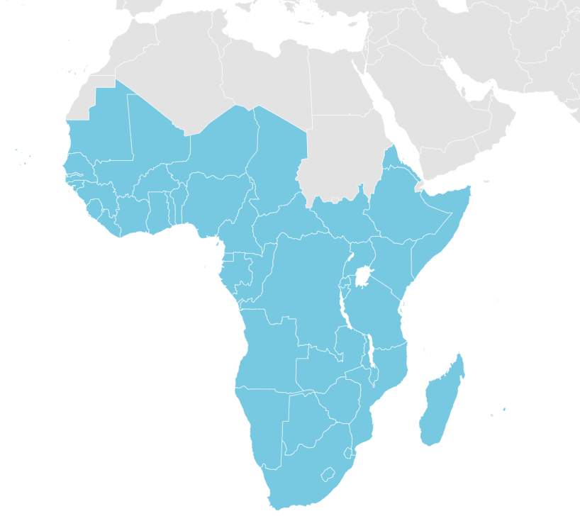
The Examples of GVC Index Application

Slide 35

Pros and Cons of TiVA Measures
Pros:
  A coherent analytical framework across countries
  More consistent with other macro economic measures, such as GDP
  Better estimate of income effect from international trade
  Applicable for evaluating economic integration and comparative advantage
Cons:
  Subject to the quality and compilation principals of input data
  Too aggregate
  Non-timely
  Difficult to explain the intuitions behind TiVA measures

Slide 36

Questions?

Slide 37
Calculating Value Added Estimates with Stata
Ricky Ubee
October 31, 2019

Slide 38
Agenda
What WIOD can be used to calculate
Overview of WIOD structure
Math ☹
Live examples

Slide 39
What we use wiod to calculate
The amount of a country’s value-added in a trade flow e.g.,
  U.S. value added in Mexico’s transport equipment exports to the world
  U.S. value-added in U.S. imports from NAFTA
  Value-added from Canada’s agriculture sector in Brazil’s imports from Bulgaria’s textiles sector
If you want to calculate value-added shares, you’ll need to calculate a base-value as well (i.e., a denominator)

Slide 40
World Input Output Database
IO tables covering
  43 countries, and the ROW
  56 sectors using ISIC rev. 4
  Years 2000–14
Tables are available in Excel, Stata, and R
2,472 rows x 2,685 columns showing the dollar value of goods/services supplied and demanded by countries/sectors

Slide 41
Math ☹
To calculate estimates of value added we need 3 matrices
  V – The value added vector, by country and sector, as a share of total output by the country/sector
  A – The matrix of intermediate supply/use values as a share of total output by the country/sector
  F (aka C) – The vector of final demand, by country and sector

Slide 42
WIOD’s structure
 |  |  | Intermediate use |  | Final Use |  | Total use 2,464 x 1 vector
 |  |  | AUS | ROW | AUS 2,464 rows | ROW 2,464 rows
 |  |  | $$1⋯N$$ | $$1⋯N$$
Supply | Australia | $$\begin{matrix}1 \\ ⋮ \\ N\end{matrix}$$ | 2,464 x 2,464 matrix |  | AUS’ use of its own final goods (sector level) | ROW’s use of final goods from AUS | AUS’ total output
 | ROW | $$\begin{matrix}1 \\ ⋮ \\ N\end{matrix}$$ |  |  | AUS’ use of final goods from ROW (sector level) | ROW’s use of its own final goods | ROW’s total output
Value added |  |  | AUS’ value added | ROW’s value added
 |  |  | 1 x 2,464 vector
Total supply |  |  | AUS’ total output | ROW’s total output
 |  |  | 1 x 2,464 vector

Slide 43
What we need to manipulate
 |  |  | Intermediate use |  | Final Use |  | Total use 2,464 x 1 vector
 |  |  | AUS | ROW | AUS 2,464 rows | ROW 2,464 rows
 |  |  | $$1⋯N$$ | $$1⋯N$$
Supply | Australia | $$\begin{matrix}1 \\ ⋮ \\ N\end{matrix}$$ | 2,464 x 2,464 matrix |  | AUS’ use of its own final goods (sector level) | ROW’s use of final goods from AUS | AUS’ total output
 | ROW | $$\begin{matrix}1 \\ ⋮ \\ N\end{matrix}$$ |  |  | AUS’ use of final goods from ROW (sector level) | ROW’s use of its own final goods | ROW’s total output
Value added |  |  | AUS’ value added | ROW’s value added
 |  |  | 1 x 2,464 vector
Total supply |  |  | AUS’ total output | ROW’s total output
 |  |  | 1 x 2,464 vector

Slide 44
More Math ☹☹☹
The following equation is used to calculate value added:
  Value added = V [I – A]⁻¹ F
  Where I is the identity matrix with dimensionality of A
Because we won’t make any changes to A, we simplify
  Value added = VBF

Slide 45
What we need to define for a calculation
Source of value added
Two trading partners
Trade flow

Slide 46
STATA TIME!

