Slide 1
EDIS 3.10
What’s New
Notes:
Hello and welcome to the EDIS Training Webinar Series. This Webinar is meant to be an overview of the new features available in version 3.10 of EDIS. You can receive more detailed training any time on these and other features of EDIS by viewing the additional webinars posted on the EDIS support page.

Slide 2
What is New?
Updated Look and Feel (Similar to other USITC applications)
User Account Upgrades
Locked Accounts Will Now Unlock after 15 Minutes
No Longer Required to Enter a Captcha Text at Login.
Easier to use “Submission Wizard” Card System for the Submission Process
Basic Search Added as a Search Option
New Features for Advanced Search
Filter Search Results
Edit Search Results Fields
Save Searches
Export Search Results
Notes:
The first and most obvious update in EDIS 3.10 is the look and feel of the application. EDIS 3.10 more closely resembles other USITC web applications.
Second, we’ve made it easier to access your account. Users no longer need to enter captcha text when logging in and upon lock out due to too many failed password attempts, user accounts will automatically be re-activated after 15 minutes.
Third, file submission has been converted to a card system to guide users through the process based on a decision assistance tree to promote more accurate filing.
Fourth, the new Basic Search feature has been added for less complex search options.
Finally, the Advanced Search has been updated to provide options for filtering within your search results, controlling the display of the results, saving frequent searches, and exporting your search results.
The following webinar will briefly outline the last three new features, the submission wizard, basic search, and new advanced search features.

Slide 3
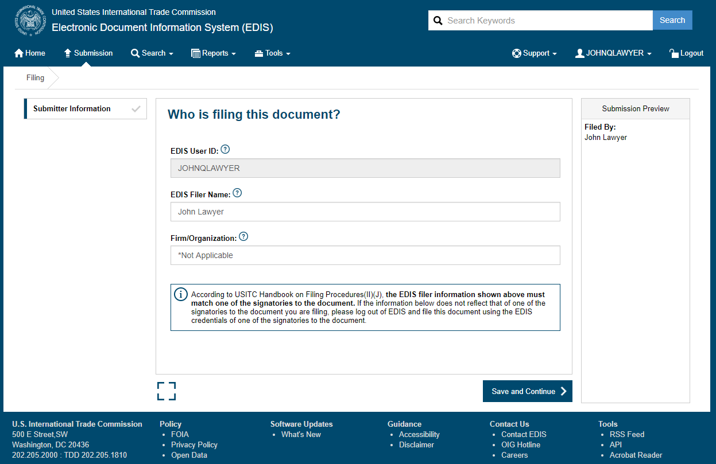
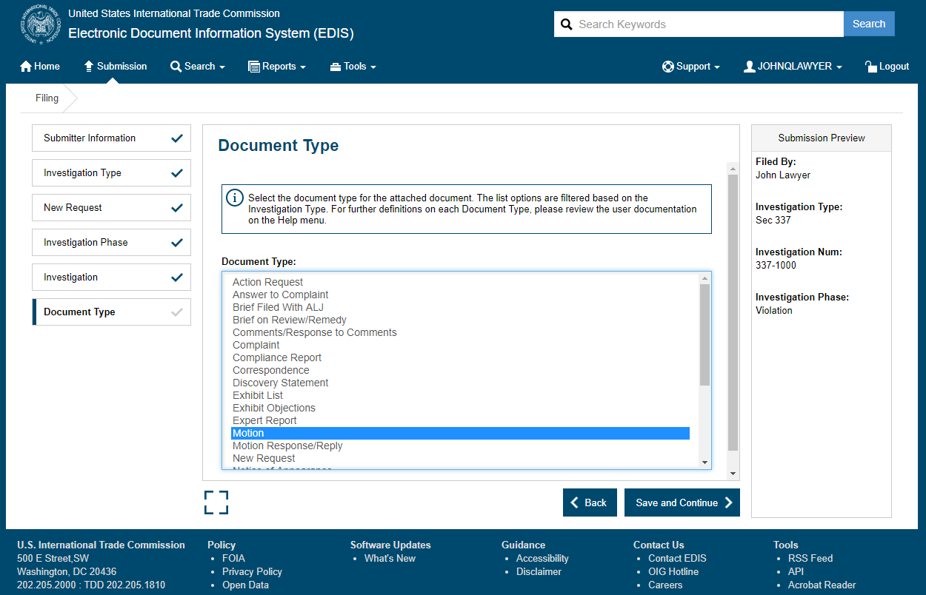
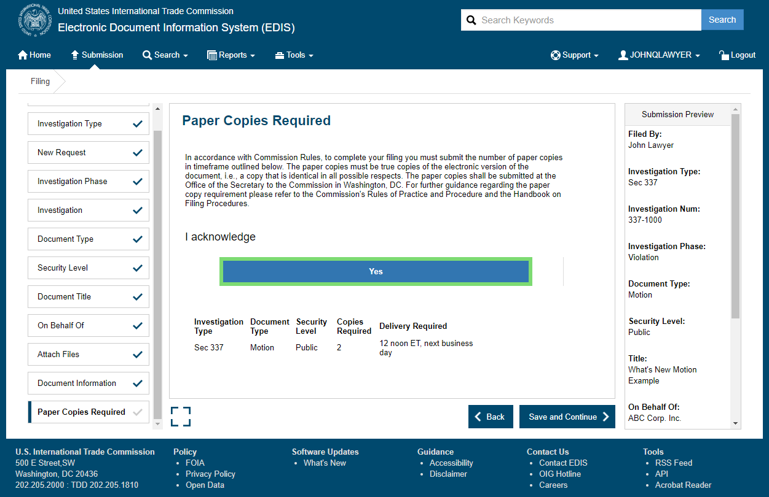
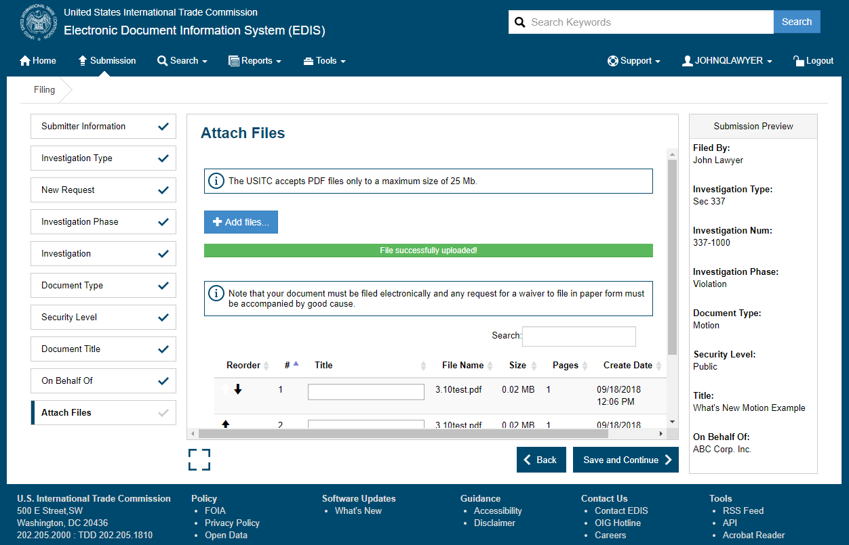
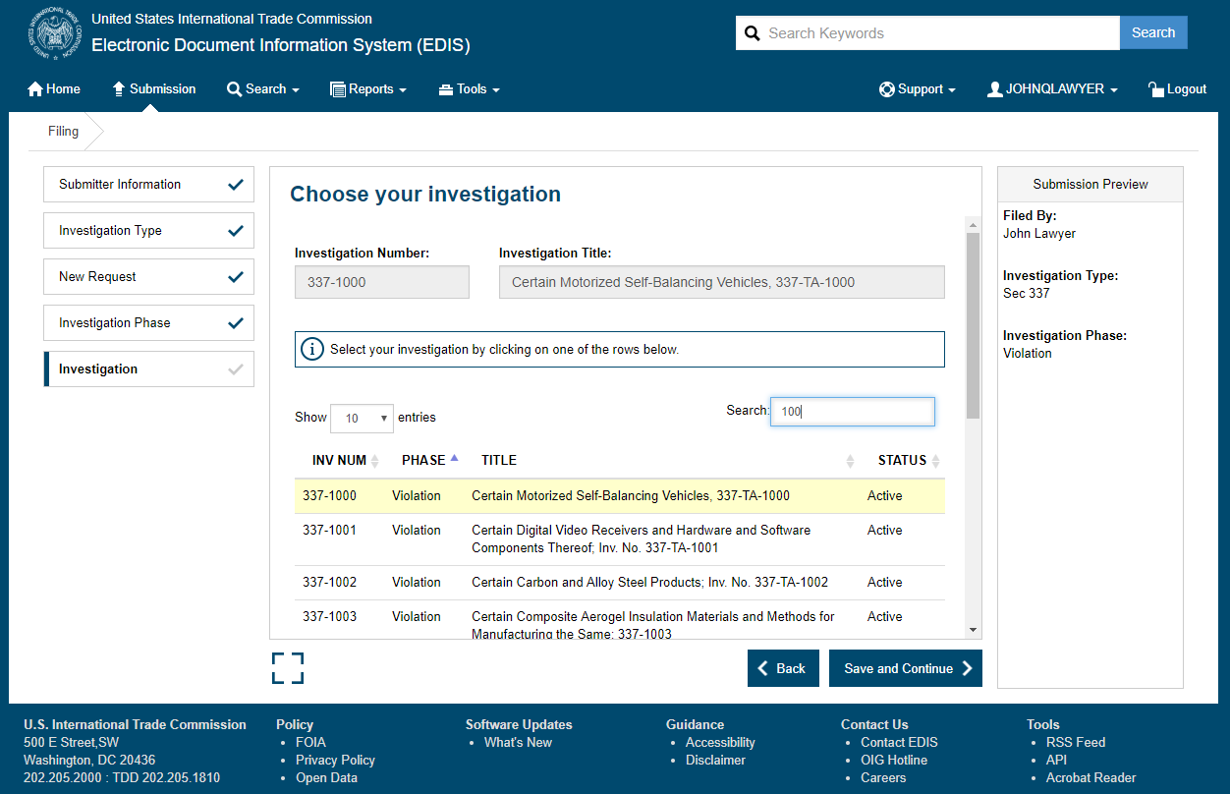
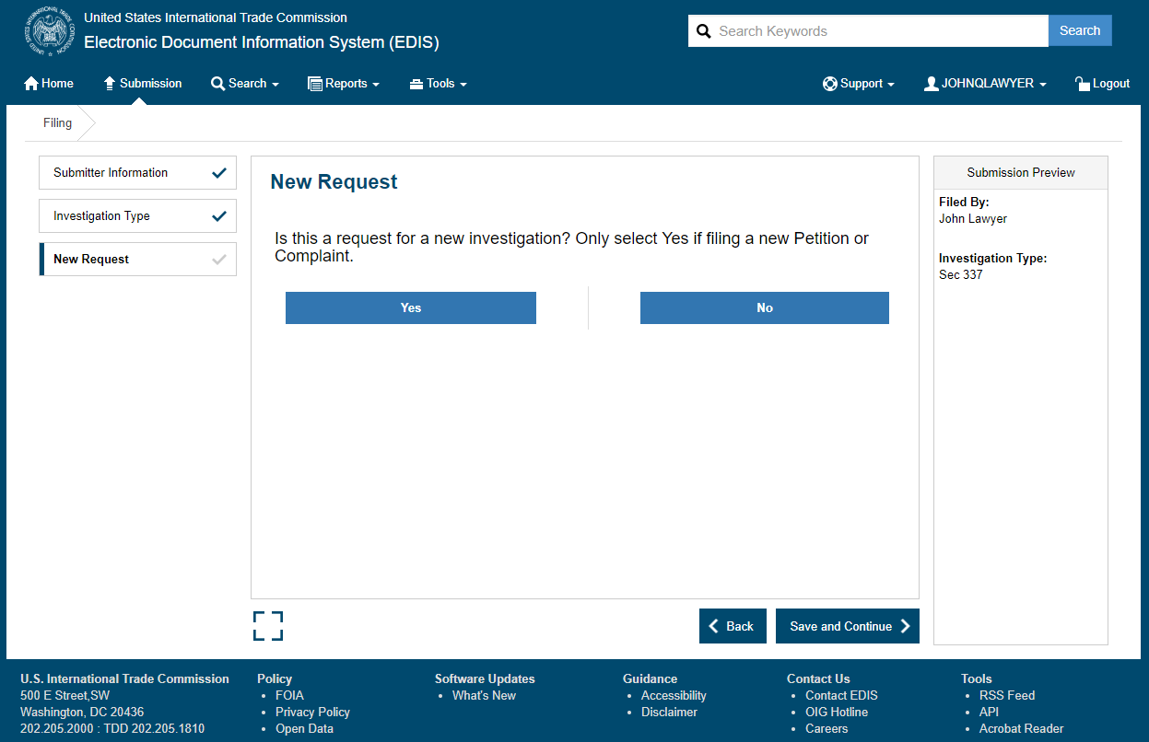
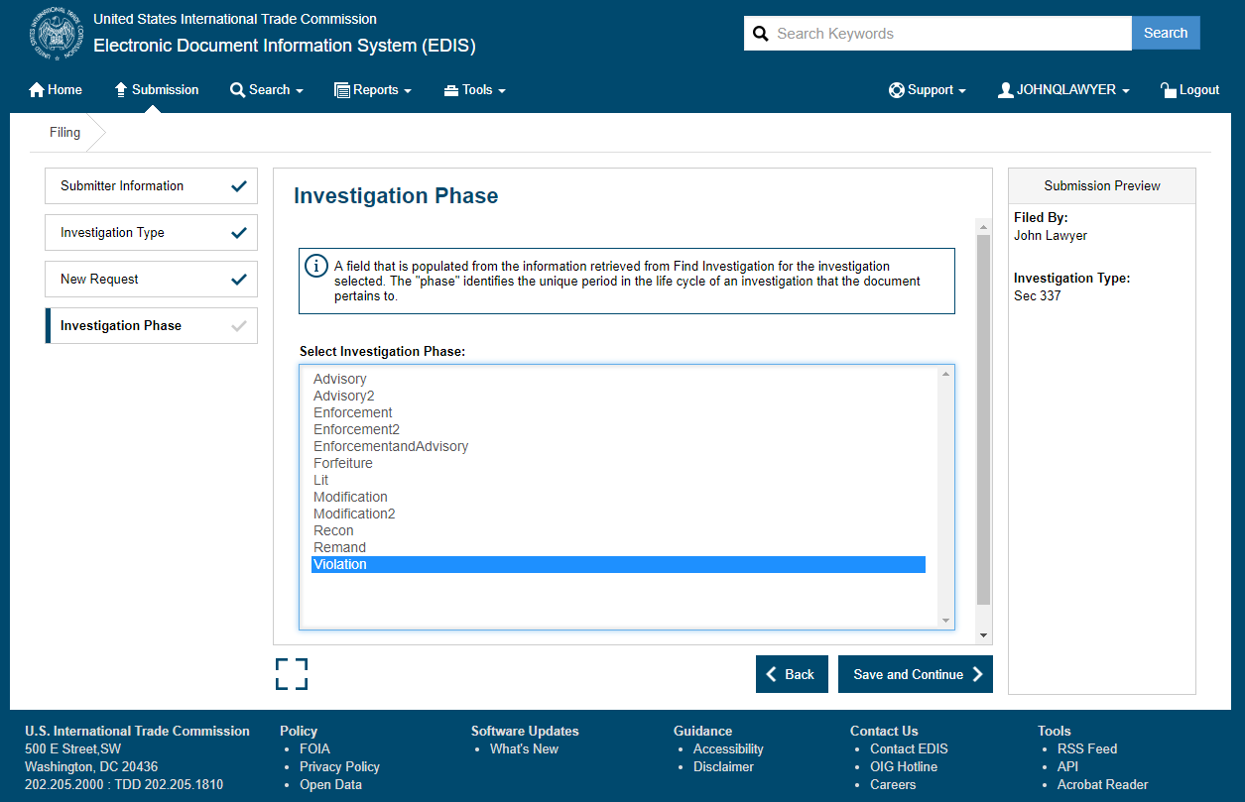
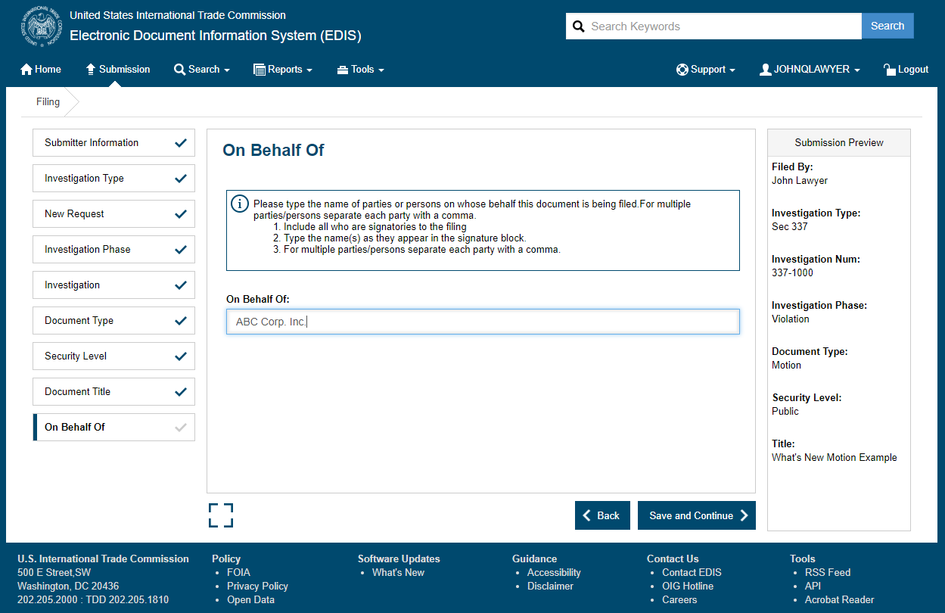
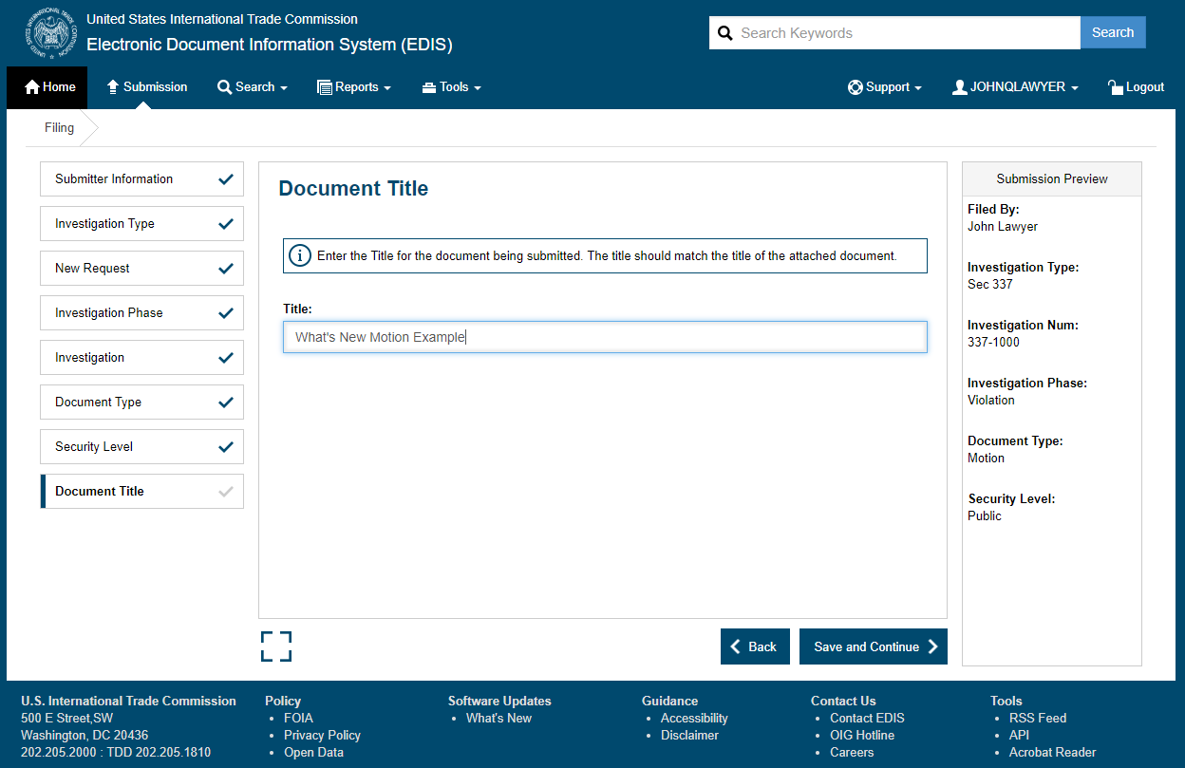
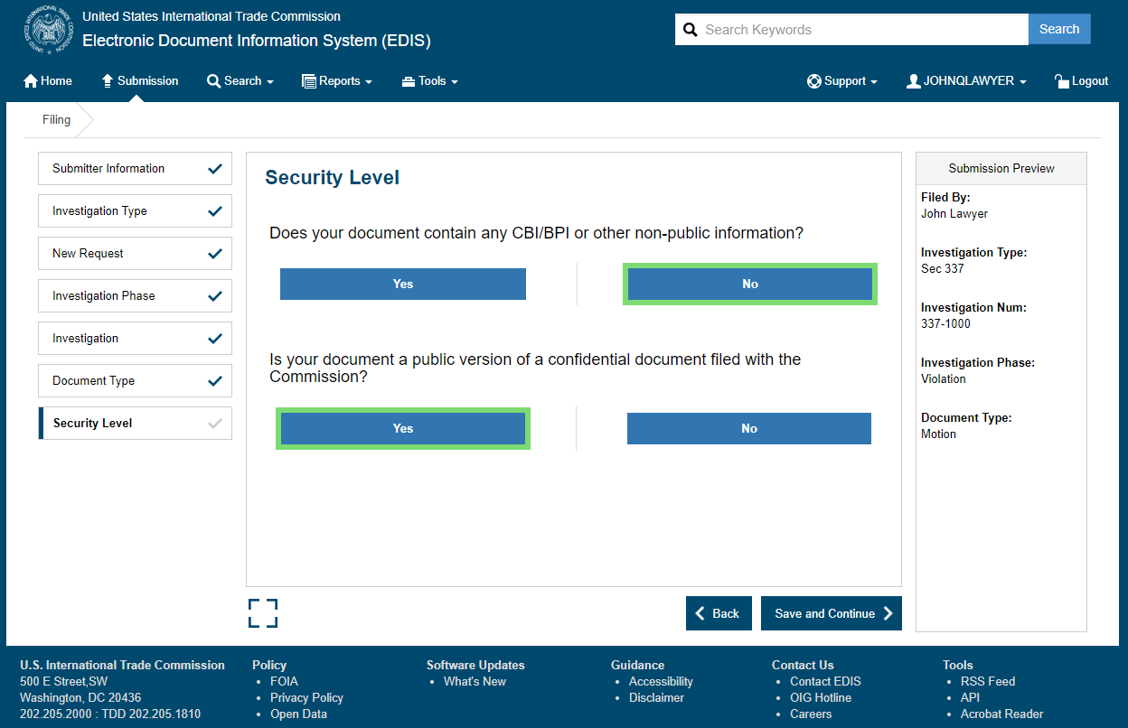
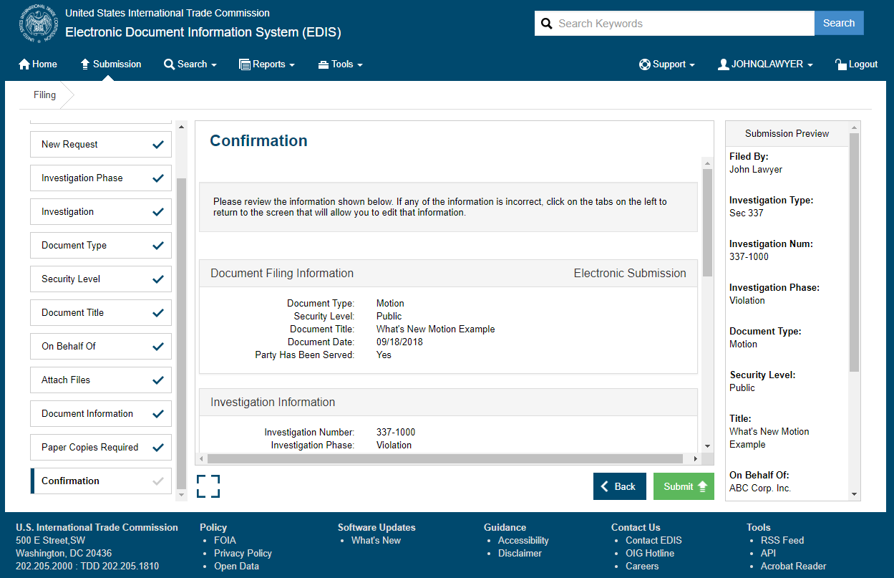
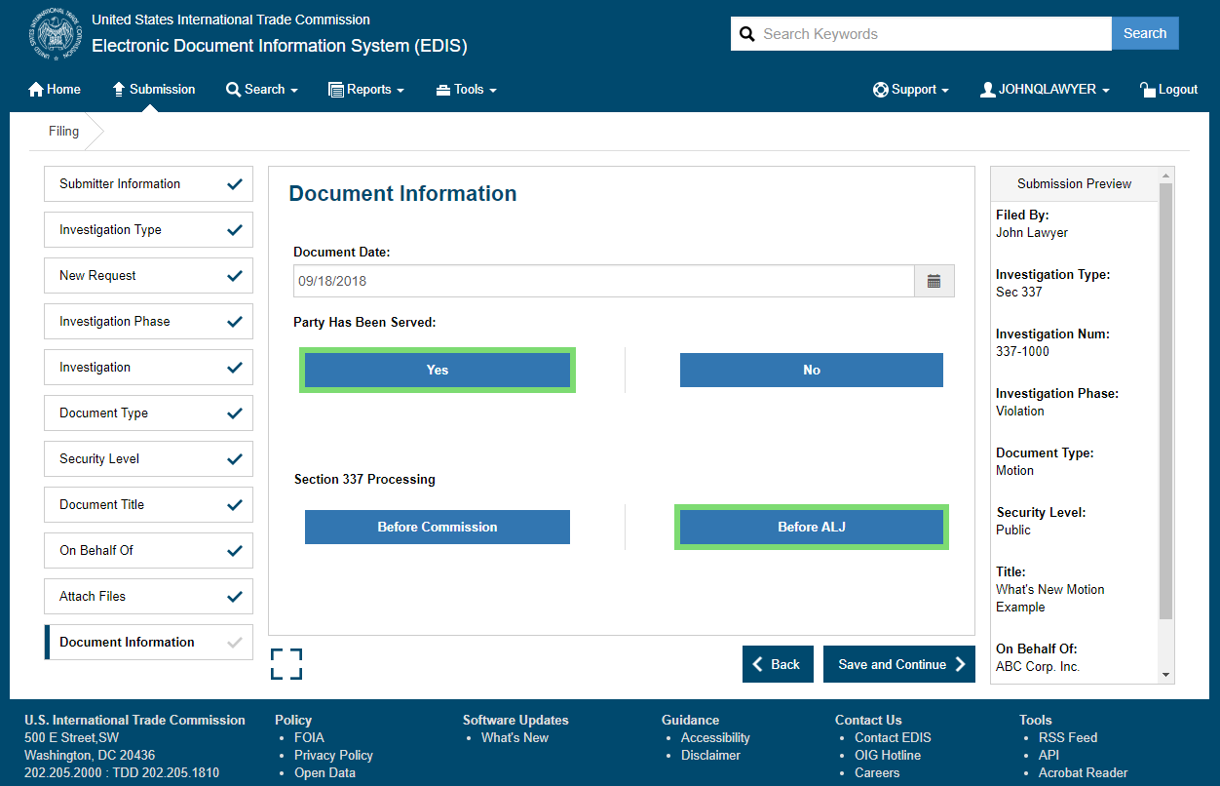
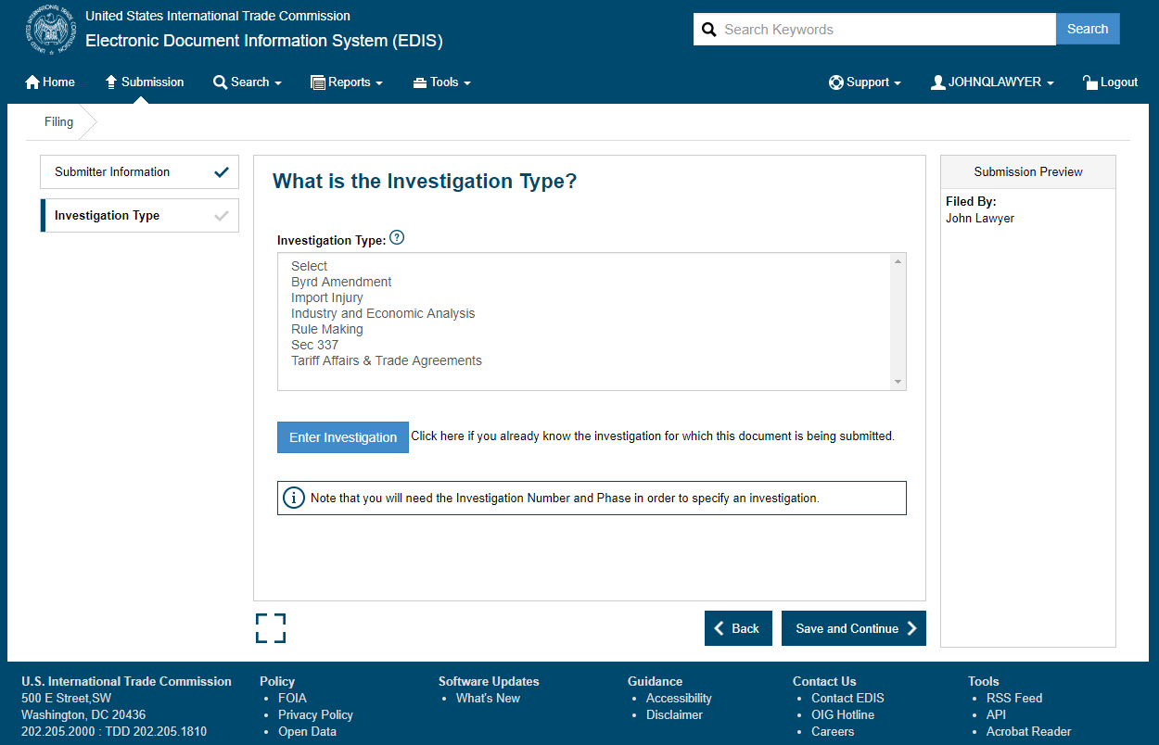
Card Based Submission Process A new “submission wizard” will guide users through the submission process, easing the learning curve for new filers and promoting accurate and consistent filings.
Notes:
We will begin by discussing the new submission features.
The new “submission wizard” will guide users through the submission process, easing the learning curve for new filers and promoting accurate and consistent filings.
On the left-hand side of the screen during the submission process, users will be able to toggle back and forth between different cards in order to easily edit any part of their submission prior to filing.
On the right-hand side of the screen users will be shown a progression of their entered metadata in the Submission Preview.

Slide 4
Card Based Submission Process A new “submission wizard” will guide users through the submission process, easing the learning curve for new filers and promoting accurate and consistent filings.
Notes:
Once a submission is complete, users will now have the option of either filing another document in the same investigation or of filing a document in a new investigation. Selecting to file another document in the same investigation will result in the application auto populating many of the fields in the submission process for the subsequent filing.

Slide 5
Three Different Search Options
Basic Search (New Search Option)
Advanced Search (New Features)
Investigation Search
Notes:
The next new feature in EDIS 3.10 is Basic Search.
With the addition of a “Basic Search” function, EDIS 3.10 now has three separate mechanisms by which to search for documents in the application: Basic Search, Advanced Search, and Investigation Search. Investigation search has not changed, so we will not be covering it in this webinar. Basic search is a new search function geared toward less complex searches. The Advanced Search feature has several enhancements that will allow users to better control and use their results.

Slide 6
Basic Search New Search Option
Notes:
Basic and Advanced search are geared toward finding documents across investigations that contain certain keywords or metadata. Basic search presents users with a more streamlined set of search criteria to quickly search for a specific document or documents.
Users can access basic search:
By selecting “Basic Search” from the Search Tab dropdown menu at the top of any page
By clicking on the magnifying glass icon on the home page, or
By typing anything into the Search Box at the top of any page and clicking on “Search”

Slide 7
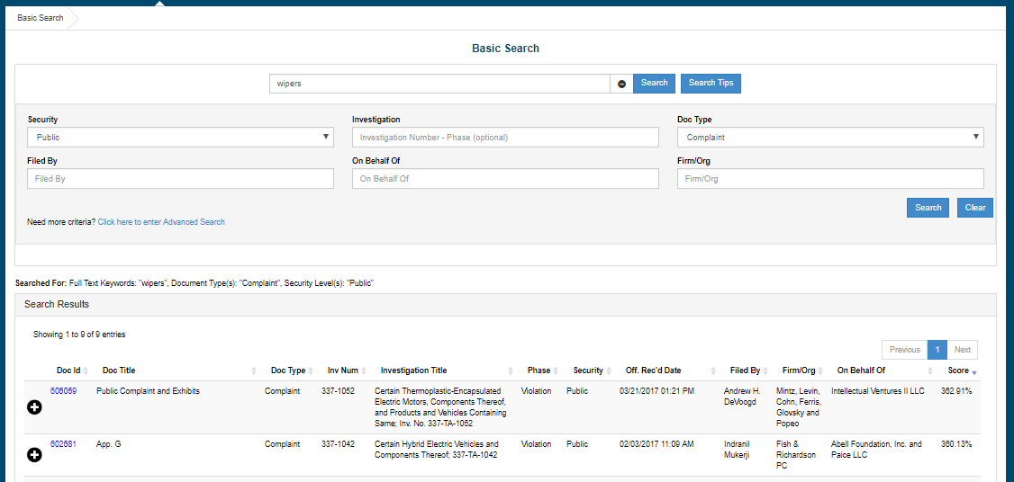
Basic Search New Search Option
Notes:
As shown here, Basic Search allows users to search by key words, security level, investigation, document type, filed by, on behalf of, and the firm/organization fields to narrow their search results. If users require additional criteria in order to narrow their search results they can simply select “Click Here to Enter Advanced Search” and they will be taken to Advanced search, where their previously entered criteria will be auto populated.

Slide 8
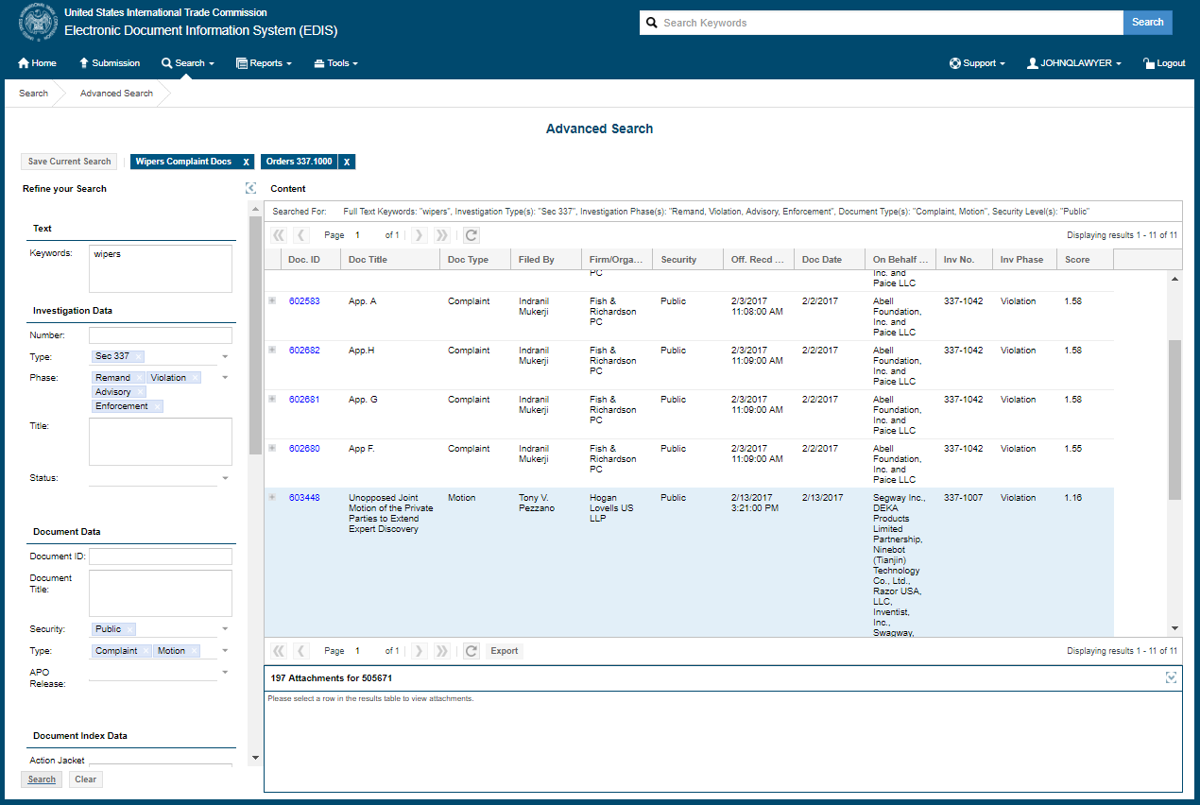
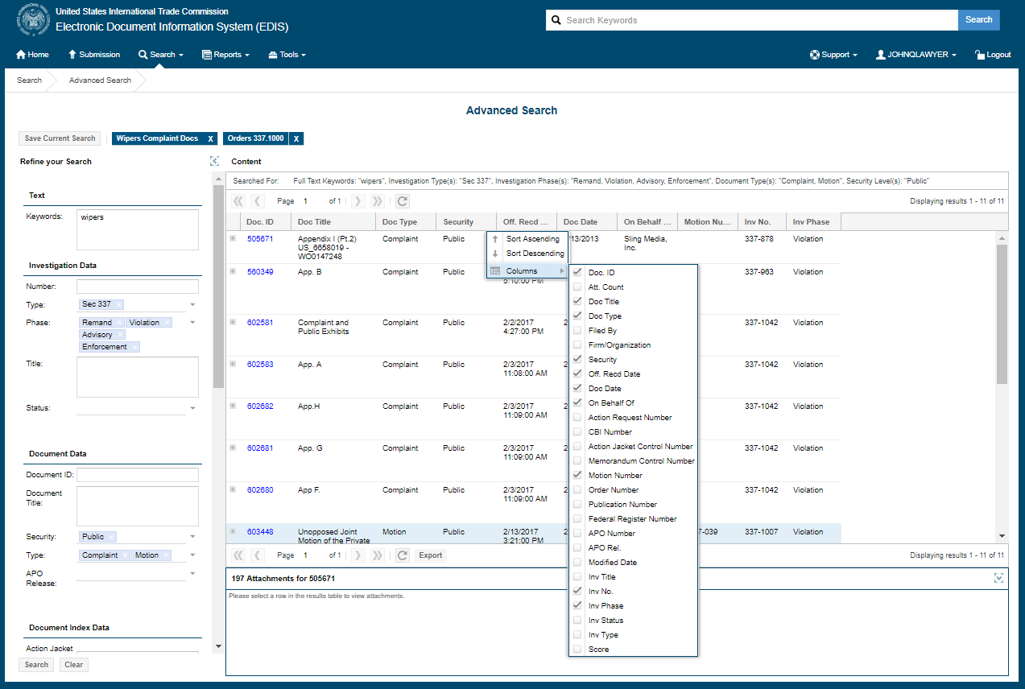
Advanced Search (New Features)
Notes:
Finally, as noted earlier, there are several new features available in Advanced Search. Users can now filter search results by adding additional search criteria while still viewing their returned results. Users can also add, remove, or reorder data columns of returned search data fields. When users perform the same search on a regular basis, they can now save any those searches to refresh their results with the click of a button. Lastly, users can now export their searches to a spreadsheet.

Slide 9
Please visit the EDIS Support page to view the rest of our EDIS 3.10 Webinar Series if you would like more detailed guidance. If you have any questions, please feel free to contact us by calling 202-205-3347, or emailing EDIS3Help@usitc.gov. The Docket Services Division of the Office of the Secretary is open from 8:45am to 5:15pm Monday-Friday and someone will be happy to assist you during those hours.

