Slide 1
2014 Trade Shifts – A Brief Overview of the New Interactive Features
Please view this presentation as a “Slide Show” by selecting the Slide Show Icon at the bottom right corner of your screen:
United States International Trade Commission
http://www.usitc.gov/research_and_analysis/trade_shifts_2014/index.htm
Updated: July 9, 2015
Please click when the green arrow appears to advance through the overview

Slide 3
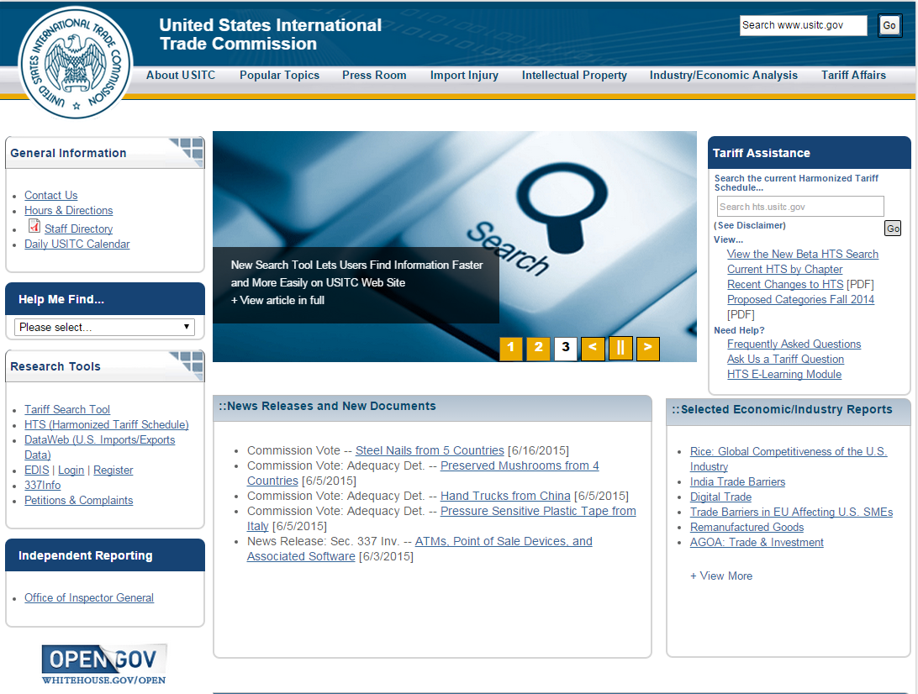
2014 Trade Shifts
This overview explains some features and enhancements you will find in the 2014 Trade Shifts.
Each year the Commission publishes a detailed analysis of Shifts in U.S. Merchandise Trade (“Trade Shifts”).
2014 Trade Shifts is accessible from the USITC homepage, www.usitc.gov ...
…or you can copy this url into your internet browser: http://www.usitc.gov/research_and_analysis/trade_shifts_2014/index.htm
Throughout the tutorial click the red Replay button to replay the slide
Replay

Slide 5
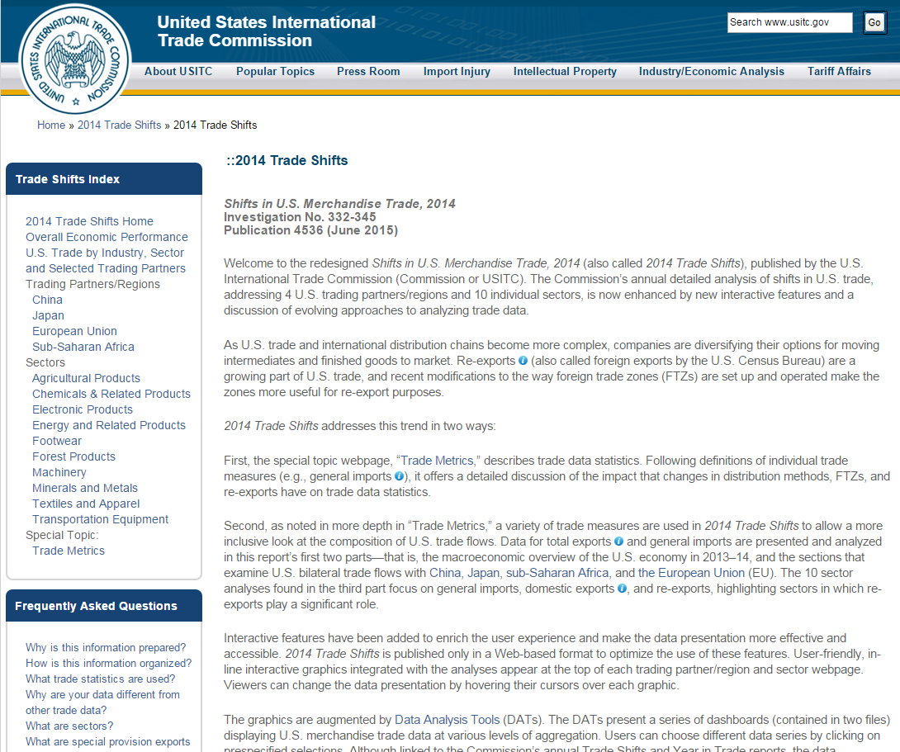
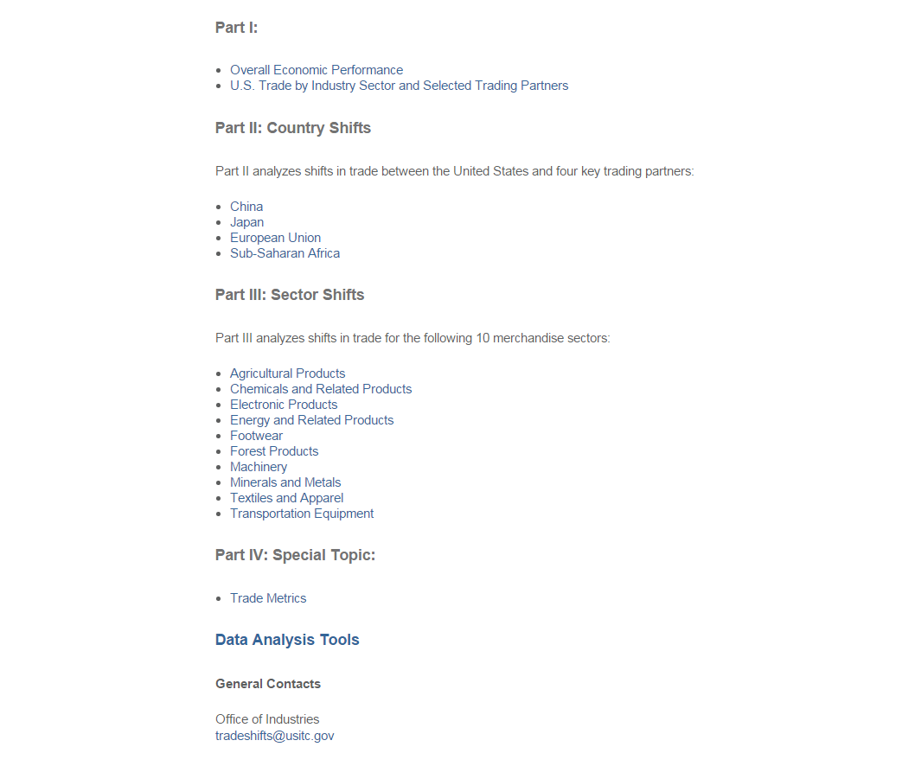
2014 Trade Shifts Home Page
The home page has several key features:
Hover over the for definitions to some key terms (if you are on a subpage, the definitions can also be accessed via the navigation panels on the left of that page).
Scroll down the page for links to the individual subpages in the document, as well as to the tables and the supplemental Data Analysis Tools (DATs).
Replay
Notes:
Indicate that the lower screen is actually the bottom of the page above (scroll down)

Slide 7
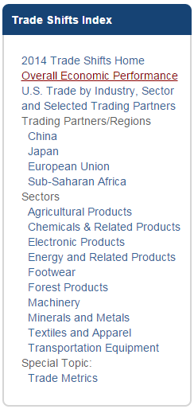
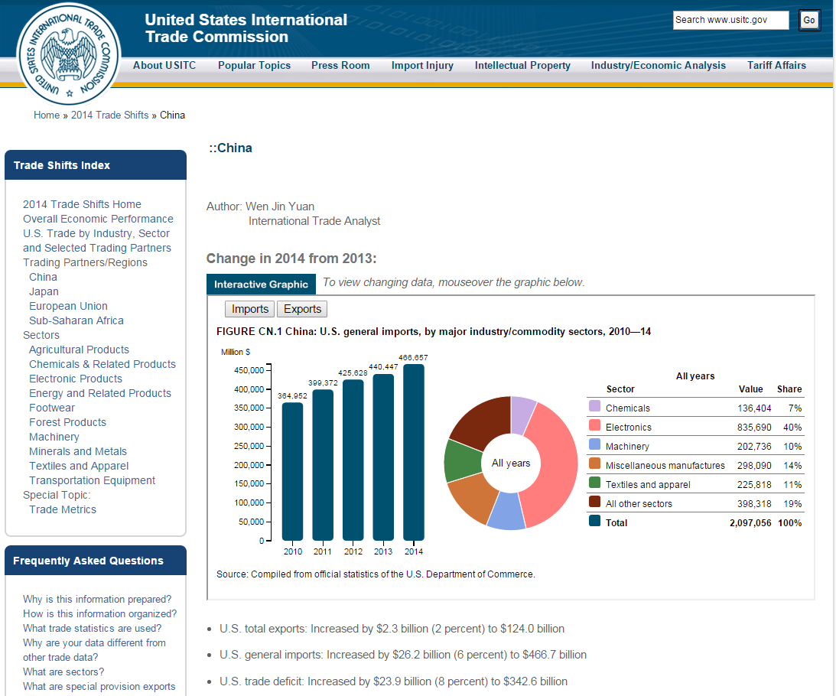
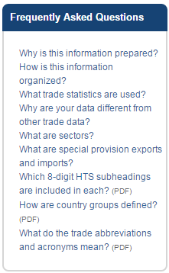
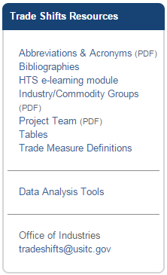
2014 Trade Shifts Industry Sector & Trading Partners Pages
Along the left side of each page in 2014 Trade Shifts are the Trade Shifts Index, Frequently Asked Questions, and Trade Shifts Resources panels that allow you to quickly navigate around the site.
When you hover over a section of the doughnut chart, the columns will dynamically adjust to show that sector’s data.
The Industry Sector and Trading Partners pages contain
Interactive Graphics
Let’s take a closer look at the Data Analysis Tools…
When you hover over a column, the doughnut chart and table will dynamically adjust to show that year’s data.
Replay

Slide 9
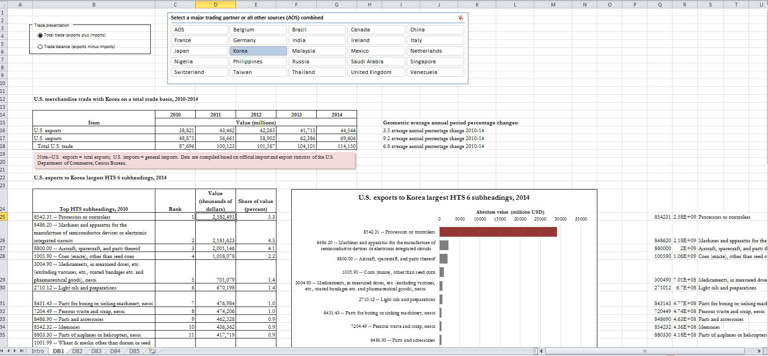
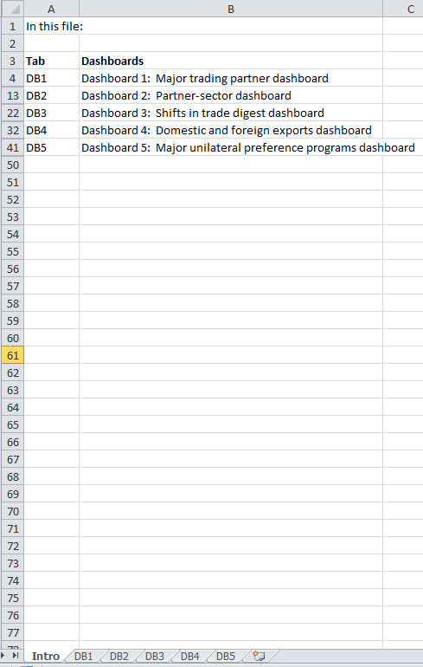
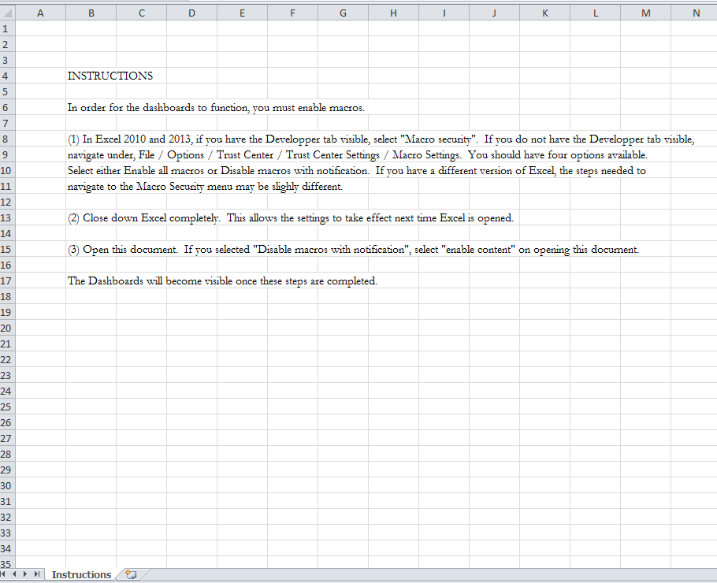
2014 Trade Shifts Data Analysis Tools (DATs)
The Data Analysis Tools are a series of dashboards, contained in two files.
Some dashboards have sliders that allow you to select a base year or time period…
…some have drop-down lists that allow you to select a digest.
Select different criteria across the top of the worksheet to adjust the data below.
When you open a file, a series of instructions will appear. Please follow these instructions so that the file opens properly.
The dashboards all function similarly. Let’s take a look at Dashboard 1: Major trading partner dashboard
The “Intro” spreadsheet defines the dashboards contained in the file
Replay

Slide 10
2014 Trade Shifts
Thank you for viewing 2014 Trade Shifts – A Brief Overview of the New Interactive Features!
Please contact us with feedback and questions regarding this overview or 2014 Trade Shifts at TradeShifts@usitc.gov

