Slide 1
337Info – A Tutorial
How to Conduct Basic Searches and Find Essential Information Using the USITC’s 337Info System
United States International Trade Commission
http://pubapps2.usitc.gov/337external/
Updated: September 30, 2014
Please click the green arrow to advance through the tutorial

Slide 2
What is 337Info?
337Info is an information retrieval system that contains data about USITC section 337 investigations, including:
the unfair act(s) alleged
the parties involved (current and historical)
the Administrative Law Judge(s) (ALJ(s)) and USITC staff assigned (current and historical)
the product(s) involved
current investigation status and key dates (date of institution, hearing dates, target dates, etc.)
disposition of the investigation as a whole and by respondent
remedial order(s) issued
any appeals and/or ancillary proceedings
337Info is not a document repository. To view official documents filed in USITC investigations, users may use the USITC Electronic Document Information System (EDIS).
337Info currently includes information about investigations instituted or otherwise initiated on or after October 1, 2008. These investigations include violation-phase, enforcement, bond forfeiture, and modification proceedings, as well as investigations following a remand from the U.S. Court of Appeals for the Federal Circuit.

Slide 4
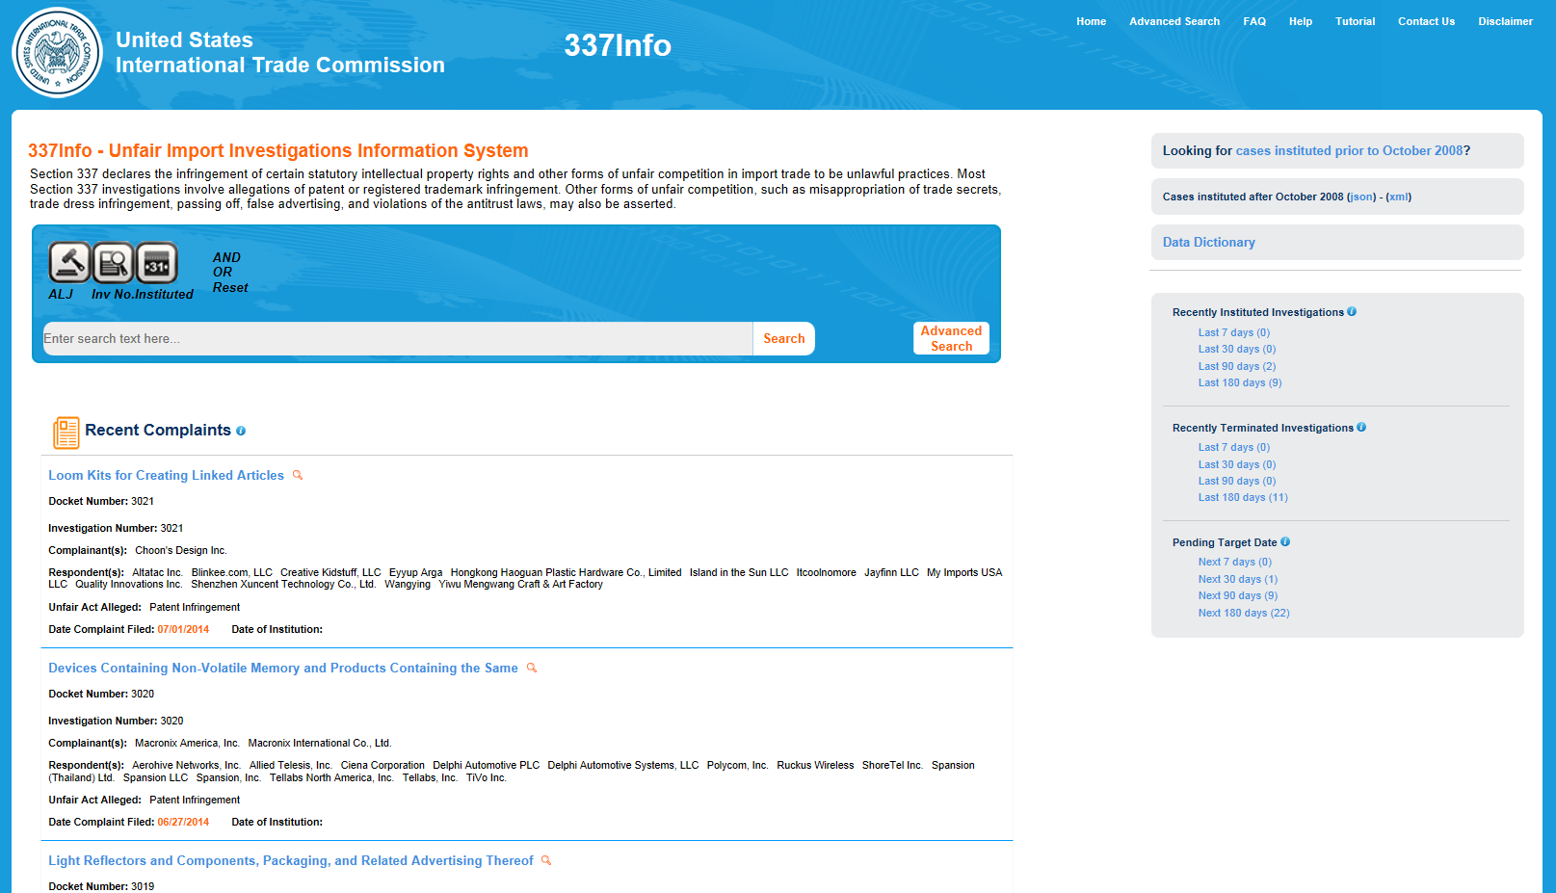
337Info Home Page
The 337Info home page has several key features:
Lists recent complaints filed with the Commission
Provides filters to quickly access investigations that meet certain criteria
Provides links to other research tools
Let’s take a closer look at these key features…
Throughout the tutorial click the red Replay button to replay the animation
Replay

Slide 6
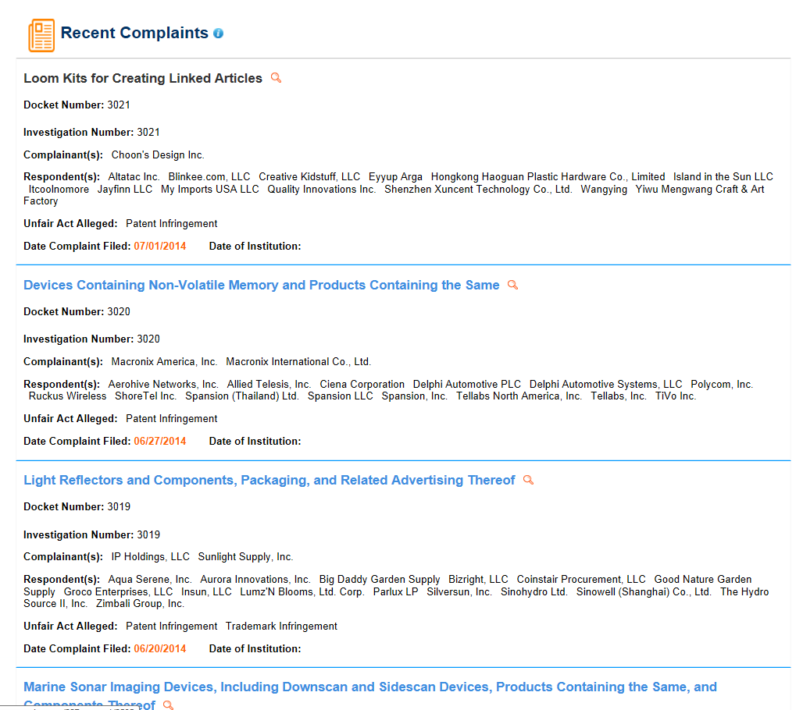
337Info Home Page
The five most recently filed complaints are listed; the most recent filing is at the top of the list
At a glance, users can find the investigation title, docket number, complainants and respondents, the unfair act(s) alleged, and key dates
Hover over the magnifying glass icon for additional quick information
Click on investigation title for full investigation information
Key Features: Recent Complaints
Replay

Slide 8
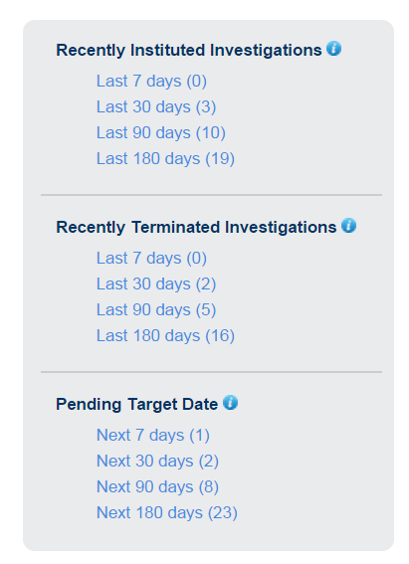
337Info Home Page
Key Features: Filters
Search by investigations instituted over specified timeframes.
Search by investigations terminated over specified timeframes.
Search by pending target dates over specified timeframes.
Replay

Slide 10
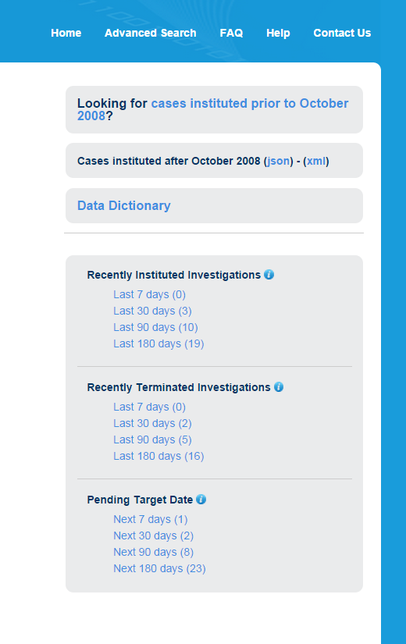
337Info Home Page
Key Features: Other Research Tools
Looking for older investigations that aren’t in the database? Check here.
Want to see all investigations in the database in a machine readable format (JSON or XML)? Check here.
Not sure what information appears in which fields? Check here.
Replay

Slide 12
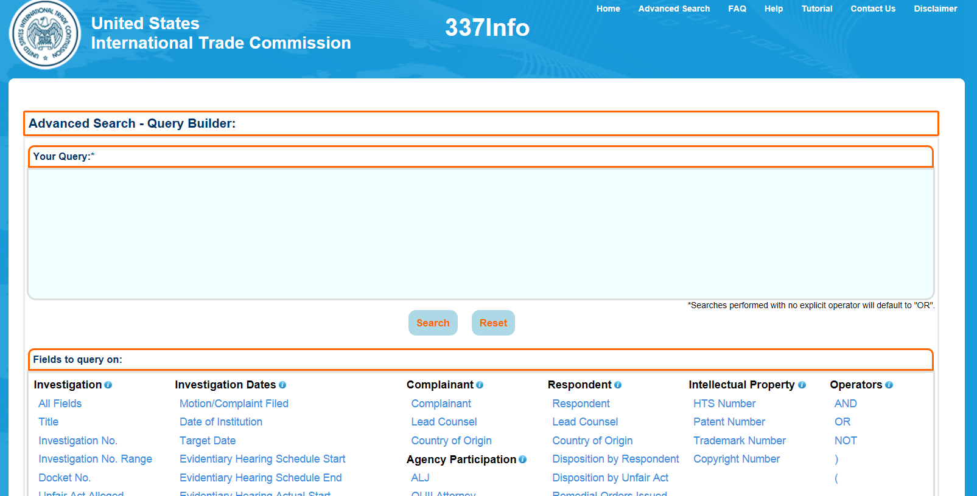
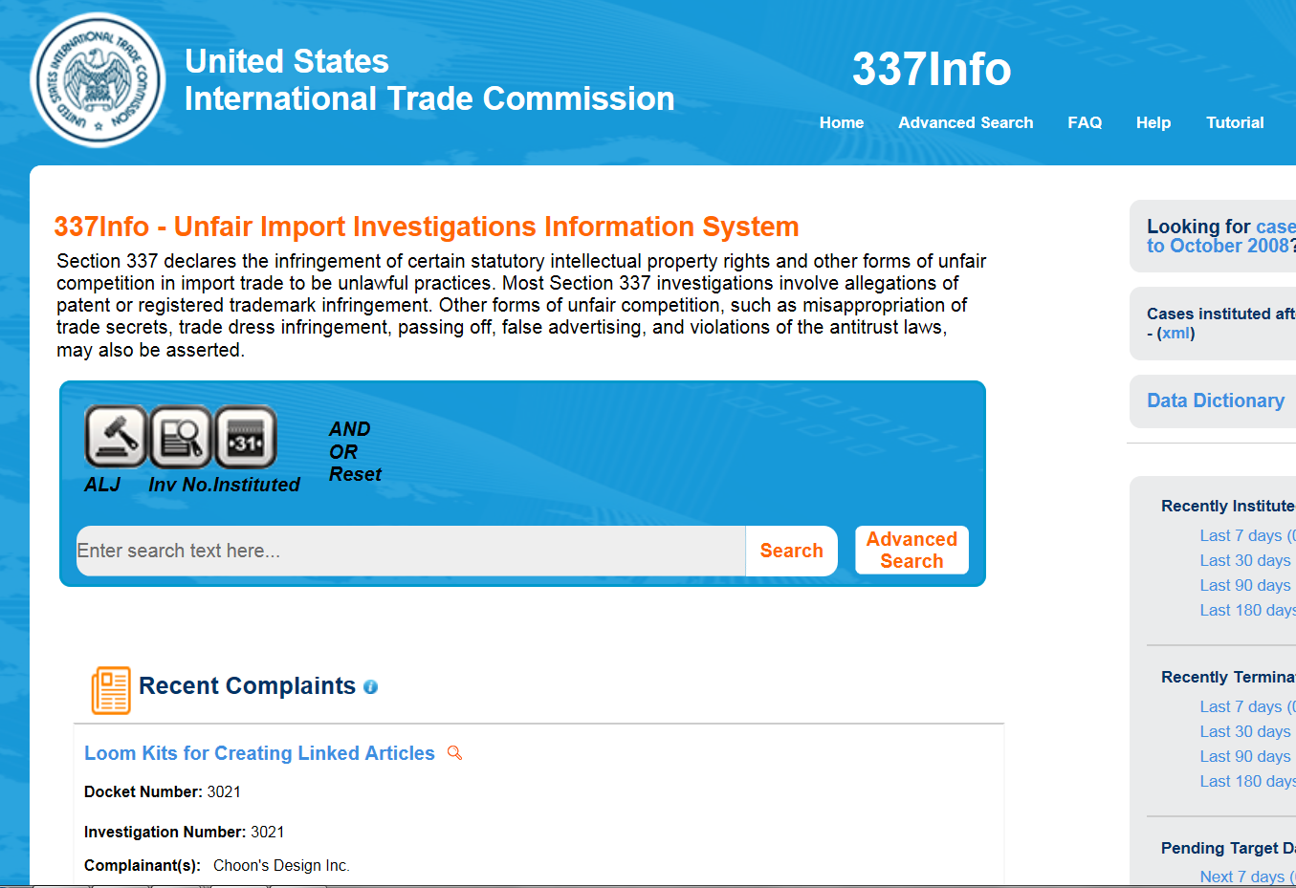
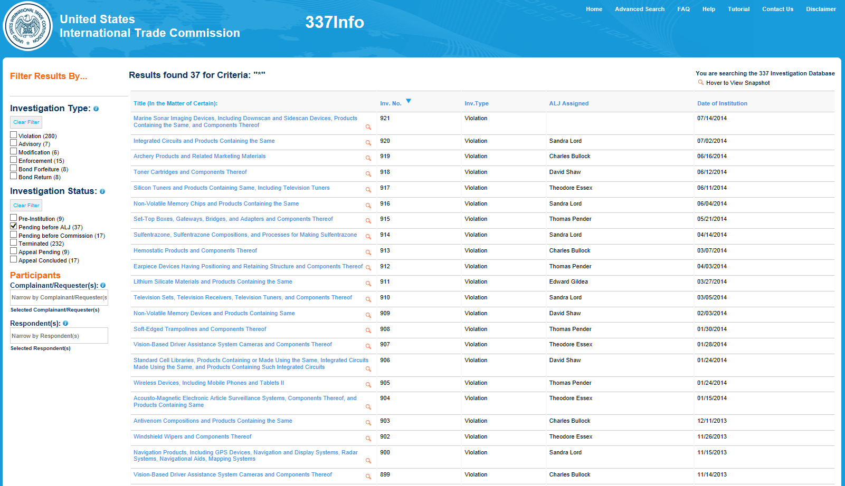
337Info Search Overview
From the home page, you can perform a quick search for key terms.
There are multiple ways to search in 337Info…
The Advanced Search function allows you to search multiple fields at the same time.
When you execute a search, your results are a list of investigations in reverse investigation number order.
Let’s take a closer look at searching in 337Info…
Replay

Slide 14
337Info Search Overview
Quick Search
Click one of these helpful icons to target your keyword search by:
Administrative Law Judge assigned
Investigation number
Date Investigation was instituted
Not finding what you want? Try an Advanced Search..
Use the boolean operators to create more complex searches.
Enter a keyword here.
Replay

Slide 16
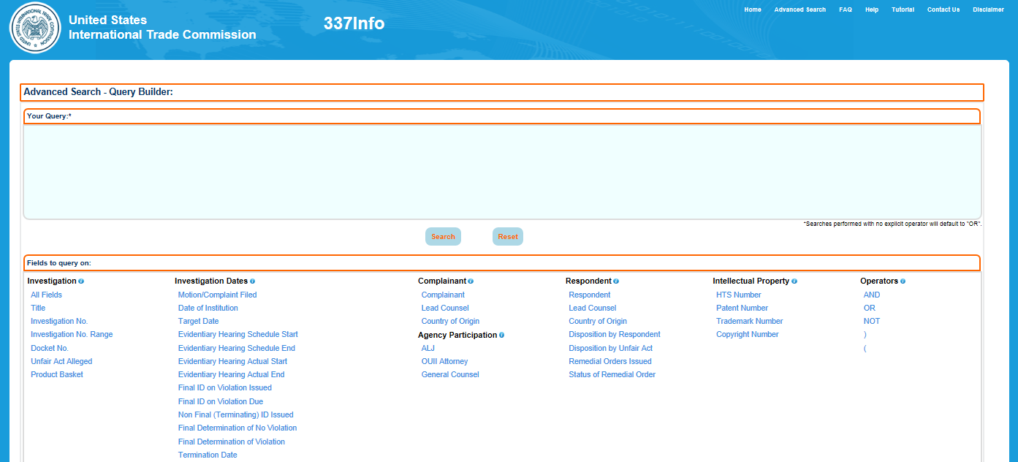
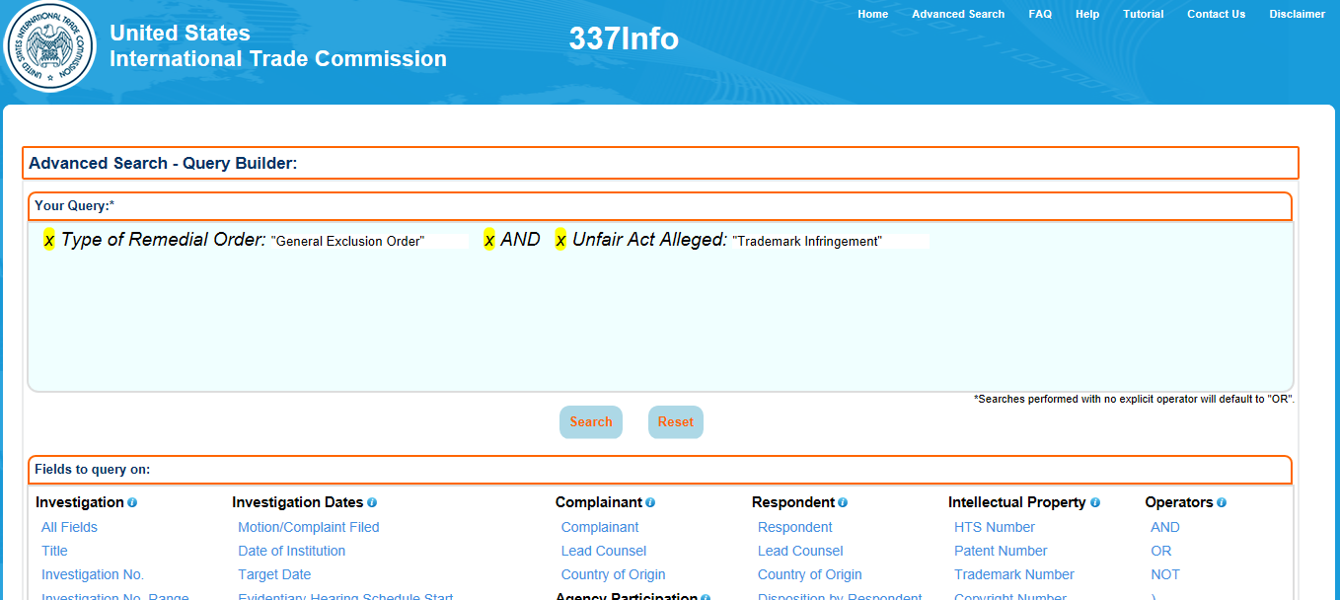
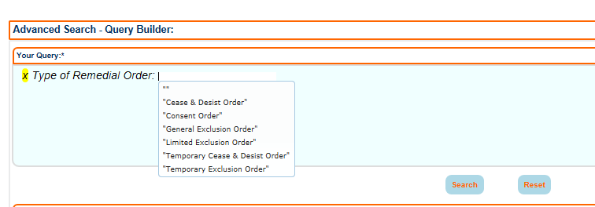
Advanced Search
Select as many fields as you want.
If you don’t select an operator, the application assumes OR.
Questions about how to build complex queries? Refer to the query syntax guide.
Enter or select your term.
Select the field you want to search by.
Click Search to execute…
…or Reset to clear.
Replay

Slide 18
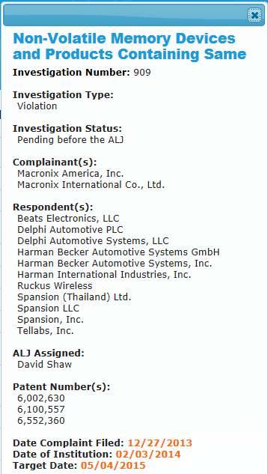
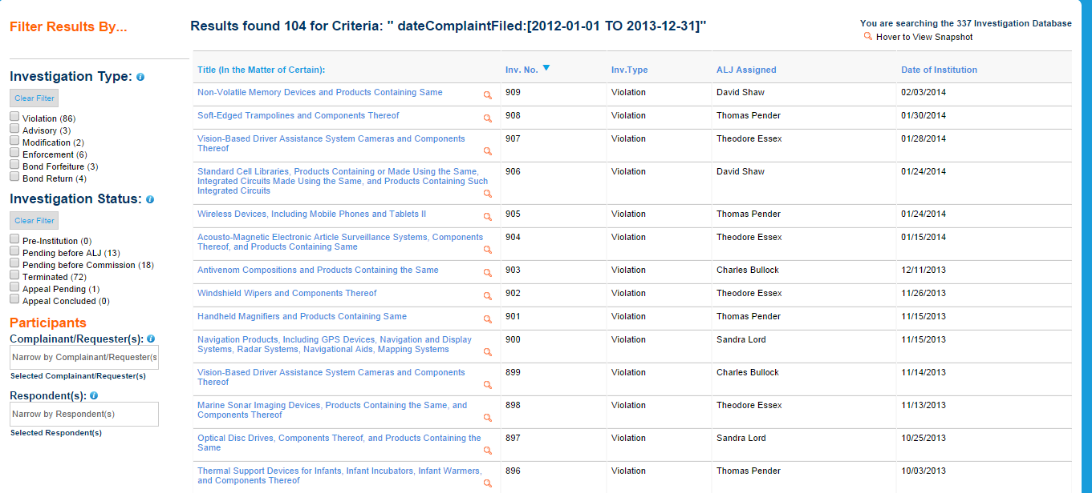
Search Results
Reorder your results by clicking on the column headers.
Use the filters to narrow your results by:
Investigation Type
Investigation Status
Complainant
Respondent
Hover over the magnifying glass for more information
Quick/Advanced Search returns a list of investigations by investigation number in reverse order…
Click the investigation title for the full investigation record
Let’s take a closer look at the full investigation record…
Replay

Slide 20
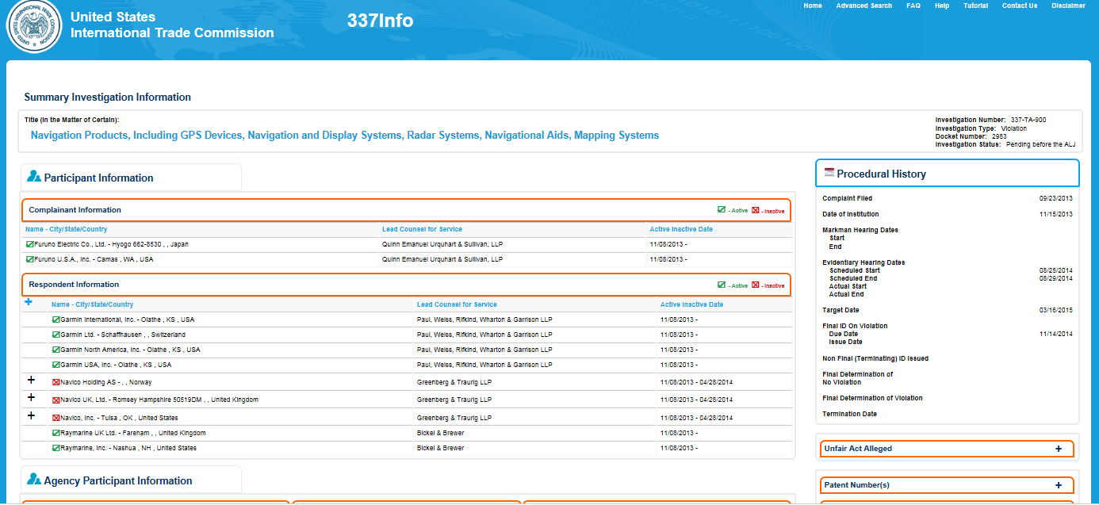
337Info Full Investigation Record
This page provides you with all the investigation information publicly available through 337Info.
Important: 337Info is not a document repository. To view official documents filed in USITC investigations, users may use the USITC Electronic Document Information System (EDIS).
Important: 337Info is not necessarily updated in real time. It is generally updated within three (3) days of Commission action.
Let’s take a closer look at the sections on this page…
Replay

Slide 22
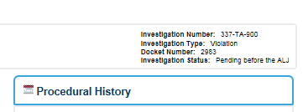
337Info Full Investigation Record
Summary Investigation Information
The Summary Investigation Information section includes:
Investigation Title
Investigation Number
Investigation Type
Docket Number
Investigation Status
Replay

Slide 24
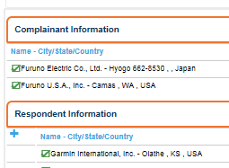
337Info Full Investigation Record
The Participant Information section includes specific information for each participant:
Name
City, State and Country
Lead Counsel (Firm Name)
Date range in which the party participated
Participant Information
A green check means the participant is currently active in the investigation.
A red X means they are inactive (e.g., have been terminated from the investigation).
Click the plus (+) sign next to a participant’s name to reveal more information, such as disposition information.
Replay

Slide 26
337Info Full Investigation Record
Agency Participant Information
Agency Participant Information includes:
The OUII staff participating and their level of participation
The assigned General Counsel staff
The Administrative Law Judge(s) that are presiding/have presided
Replay

Slide 28
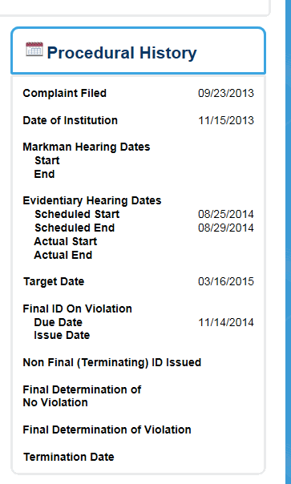
337Info Full Investigation Record
Procedural History
The Procedural History section includes key dates, such as:
Date of Institution
The date the Notice of Investigation was published in the Federal Register
Hearing dates
Both scheduled and actual
Target date
The scheduled date of completion for the investigation, which is updated to reflect any extensions
Replay

Slide 30
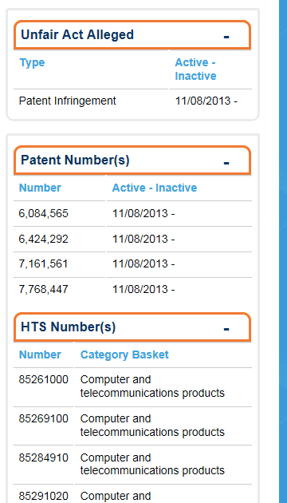
337Info Full Investigation Record
Unfair Acts, Intellectual Property, and Product Information
These sections expand to reveal information pertaining to:
The Unfair Acts Alleged
The intellectual property rights at issue
The Harmonized Tariff Schedule classification for the alleged imports
The category of the products at issue
Replay

Slide 32
337Info Full Investigation Record
If you have questions about the information included in a particular field in 337Info, please refer to the Data Dictionary linked to on the home page.
Replay

Slide 34
337Info Search Examples
Search Example #1
I want to see a list of investigations that are in the violation phase and currently pending before Chief Administrative Law Judge Bullock.
Click the ALJ search button on the home page…
Now that you know a bit about 337Info’s structure and features, let’s walk through some searches…
…the resulting search box’s asterisk (*) is a wild card character so that you may type any portion of the Chief Judge’s last name…
…and click Search.
Replay

Slide 36
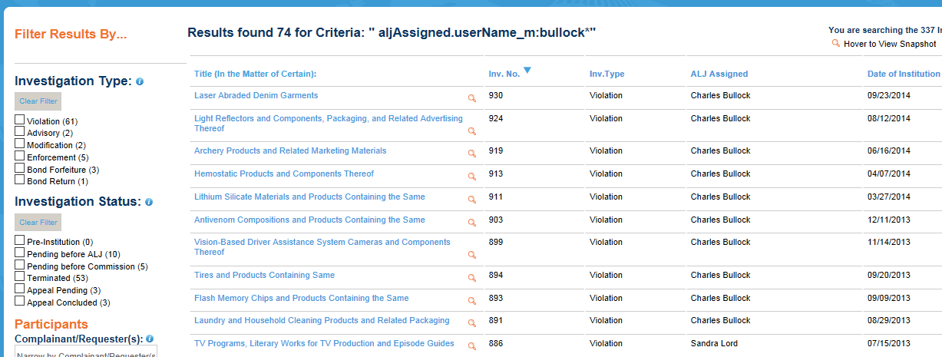
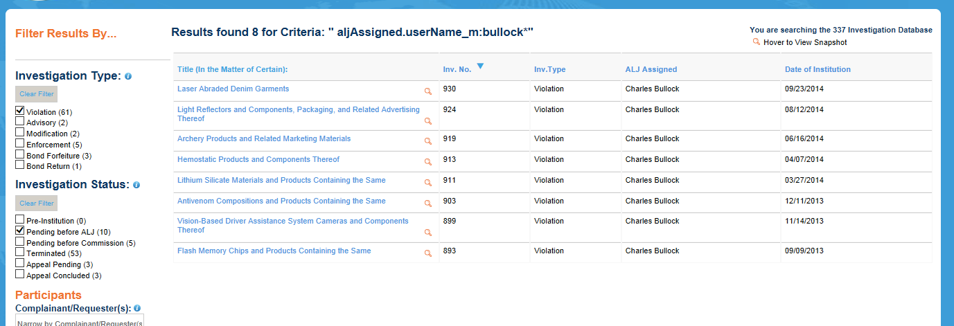
337Info Search Examples
Search Example #1
I want to see a list of investigations that are in the violation phase and currently pending before Chief Administrative Law Judge Bullock.
Your results are a list of investigations begun on or after October 1, 2008 in which Chief Judge Bullock ever presided.
Your results narrow to show only those violation cases currently pending before an ALJ and in which Chief Judge Bullock is presiding or has presided.
Use the filters to narrow your results to show only those investigations that are:
On violation
and
Currently pending before an ALJ
This column indicates the ALJ currently presiding over the investigation.
Replay
Let’s try another example…

Slide 38
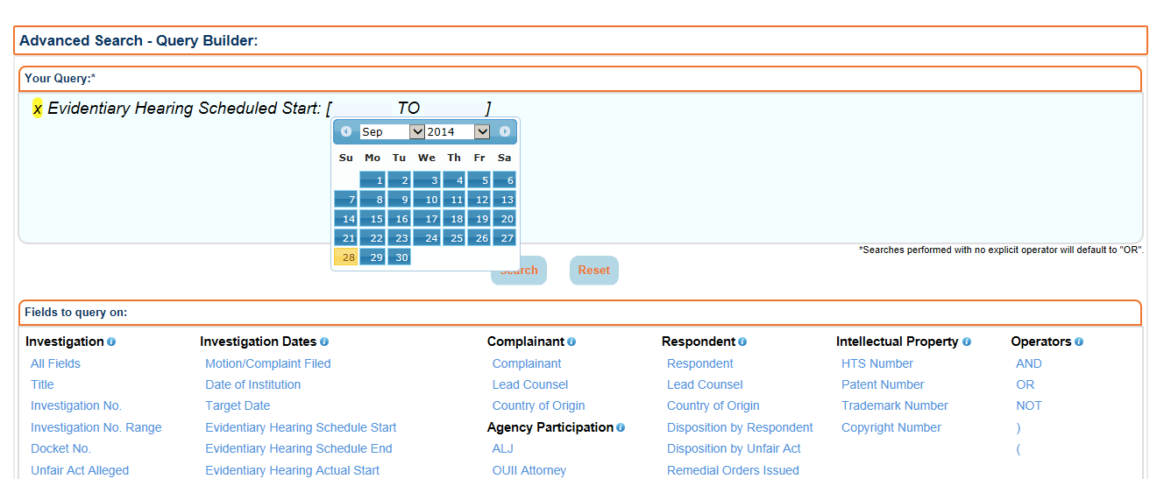
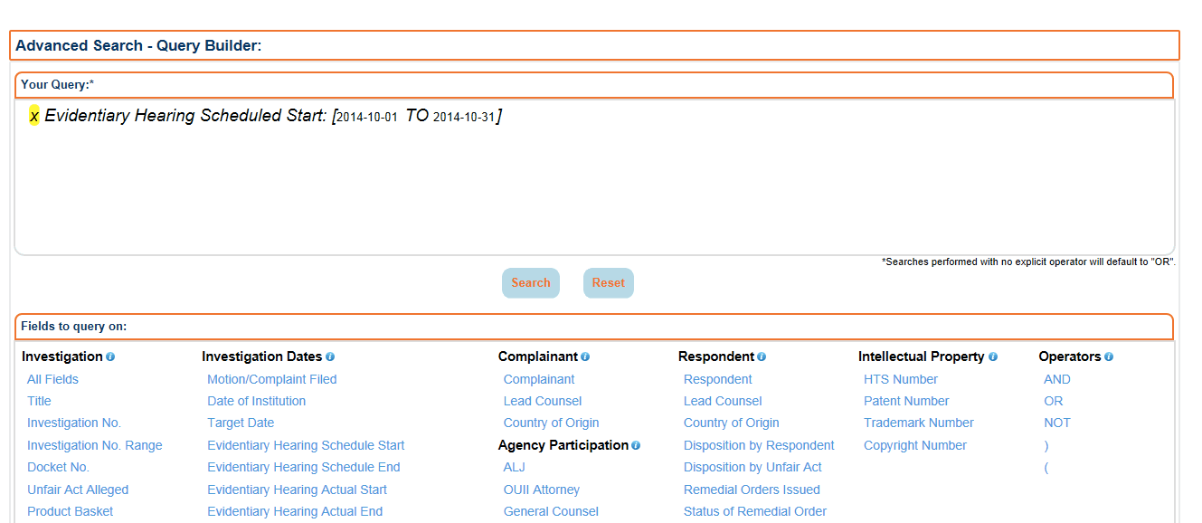
337Info Search Examples
Search Example #2
I want to see a list of investigations that have an evidentiary hearing beginning next month.
…then use the calendar selector tool to select the relevant timeframe.
Click Search.
From the Advanced Search page, select the Evidentiary Hearing Schedule Start field…
Replay

Slide 40
337Info Search Examples
Search Example #2
I want to see a list of investigations that have an evidentiary hearing beginning next month.
Please note that your results may show terminated investigations. Use the filters to be sure you are viewing only those investigations that are active at the Commission.
Replay
Let’s try one more example…

Slide 42
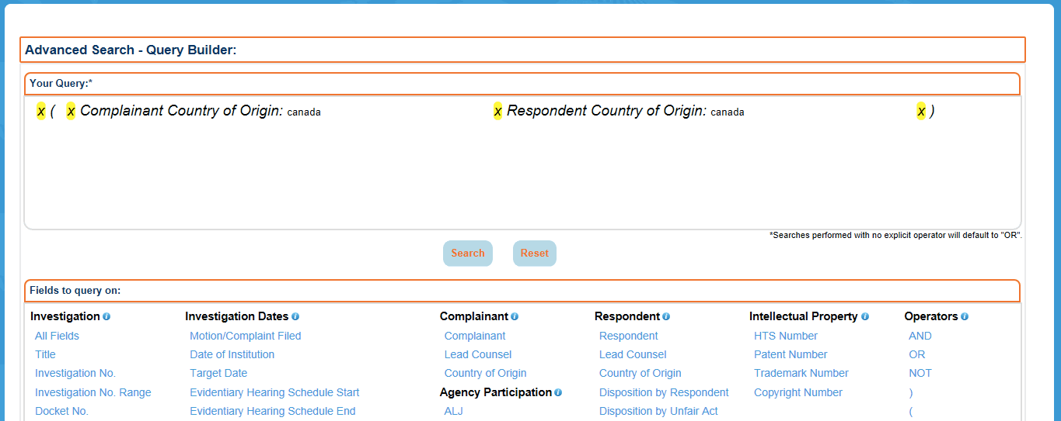
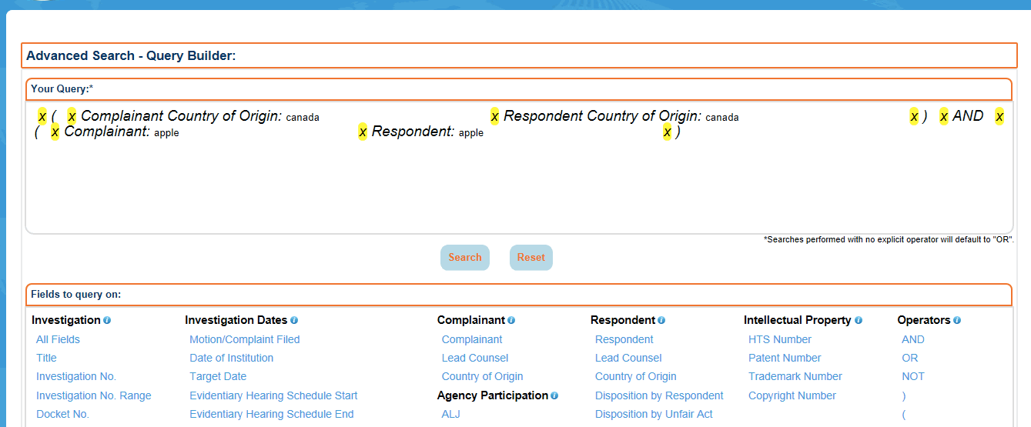
337Info Search Examples
Search Example #3
I want to see a list of investigations that involve a party from Canada and in which Apple is a party.
Connect the clauses with AND
To find investigations in which a party is from Canada, be sure to select Country of Origin under both the Complainant and Respondent headings…
Remember!
…and use the parentheses because we will be adding another clause to this search.
Be sure to select both Complainant and Respondent and use the parentheses.
Click Search.
Replay

Slide 44
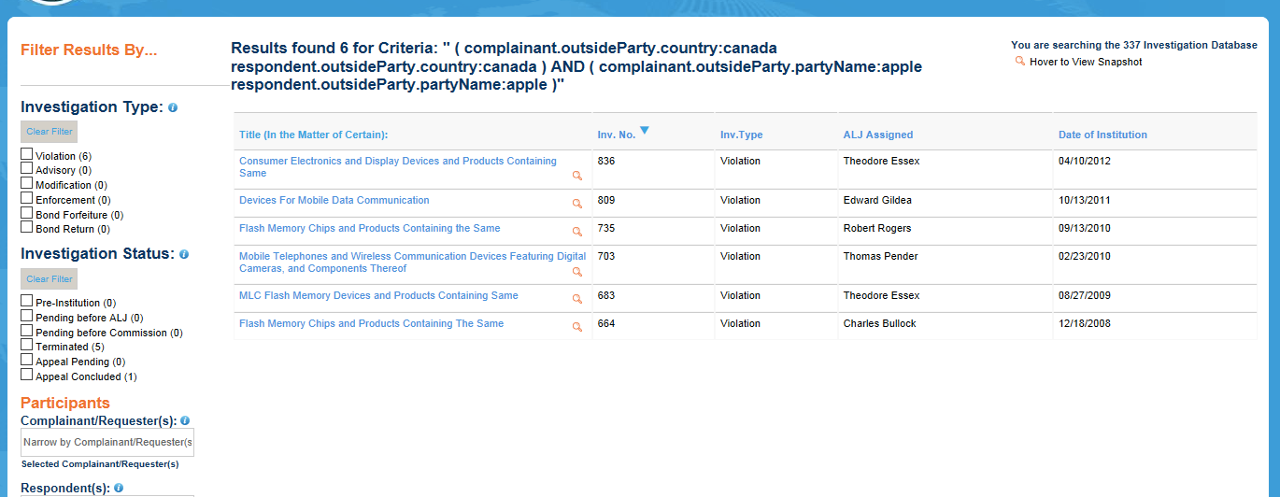
337Info Search Examples
Search Example #3
I want to see a list of investigations that involve a party from Canada and in which Apple is a party.
Double check your results by hovering over the magnifying glasses or clicking the investigation titles.
Replay
A few more search tips…

Slide 45
337Info Search Tips
REMEMBER
EMEMBER
337Info searches return a list of investigations.
It may help to phrase your question before you begin building your search query. (“I want to see a list of investigations that…”)
If you are searching on multiple fields:
Pay attention to the conjunctions you use. (The default is OR.)
Think about whether you need to use parentheses to properly group the fields.
Still have questions?…

Slide 47
337Info Help
Please refer to:
FAQs
The query syntax guide
The Data Dictionary
AND
Please use the Contact Us link to send an email to Commission staff with your questions and feedback.
Replay

Slide 48
Thank you for viewing the 337Info Tutorial

